Slide 1
Feature Effect Empirical Analysis
Preliminary Results 2024/06/18

Slide 2
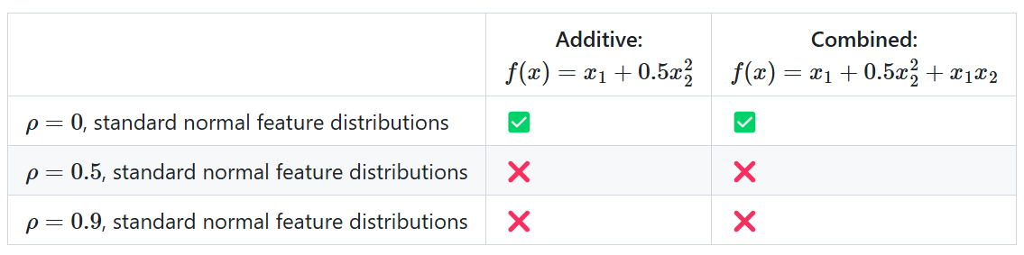
Overview
Aim: Quantification of the error between groundtruth 1D feature effect and estimated feature effects with different ML models and Feature Effect methods (PDP, ALE) for simple groundtruth functions
Data Generating Mechanisms
( )
1000 training samples
SNRs: 10, 5
20 repetitions on samples drawn with different random seeds
additionally: 2 uncorrelated random noise features with same marginals

Slide 3
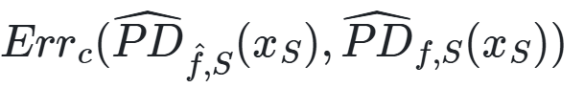
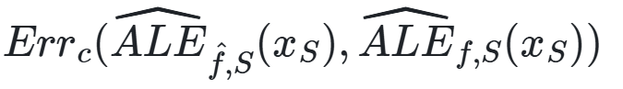
Overview
ML algorithms
GAM (correctly specified + full)
XGBoost (interactions correctly specified + full)
SVM with RBF-kernel
each tuned well for 200 iterations with TPE w.r.t. their 5-CV MSE
Feature effect methods
PDP (1D)
ALE (1D)
Performance Measures
Model Performance: MSE, MAE and R2-Score on holdout test set (10000 samples).
Feature Effect Error: Average pointwise L2-loss between centered estimated model PD (ALE) and estimated groundtruth PD (ALE) at 100 equidistant grid points

Slide 4
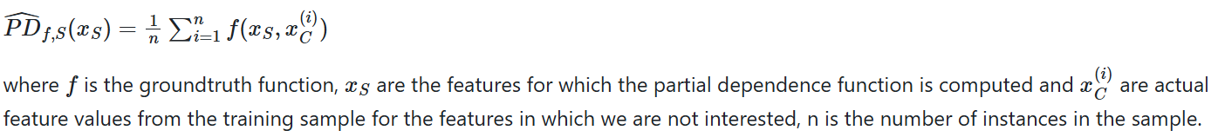
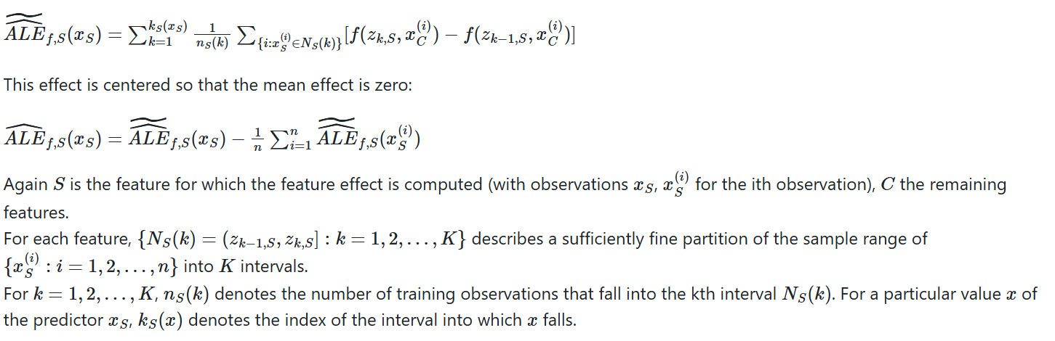
Definitions

Slide 5
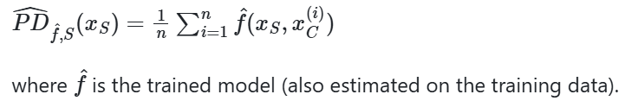
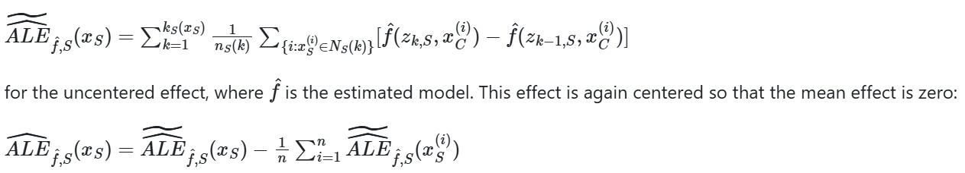
Definitions

Slide 6
Results Additive Scenario

Slide 7
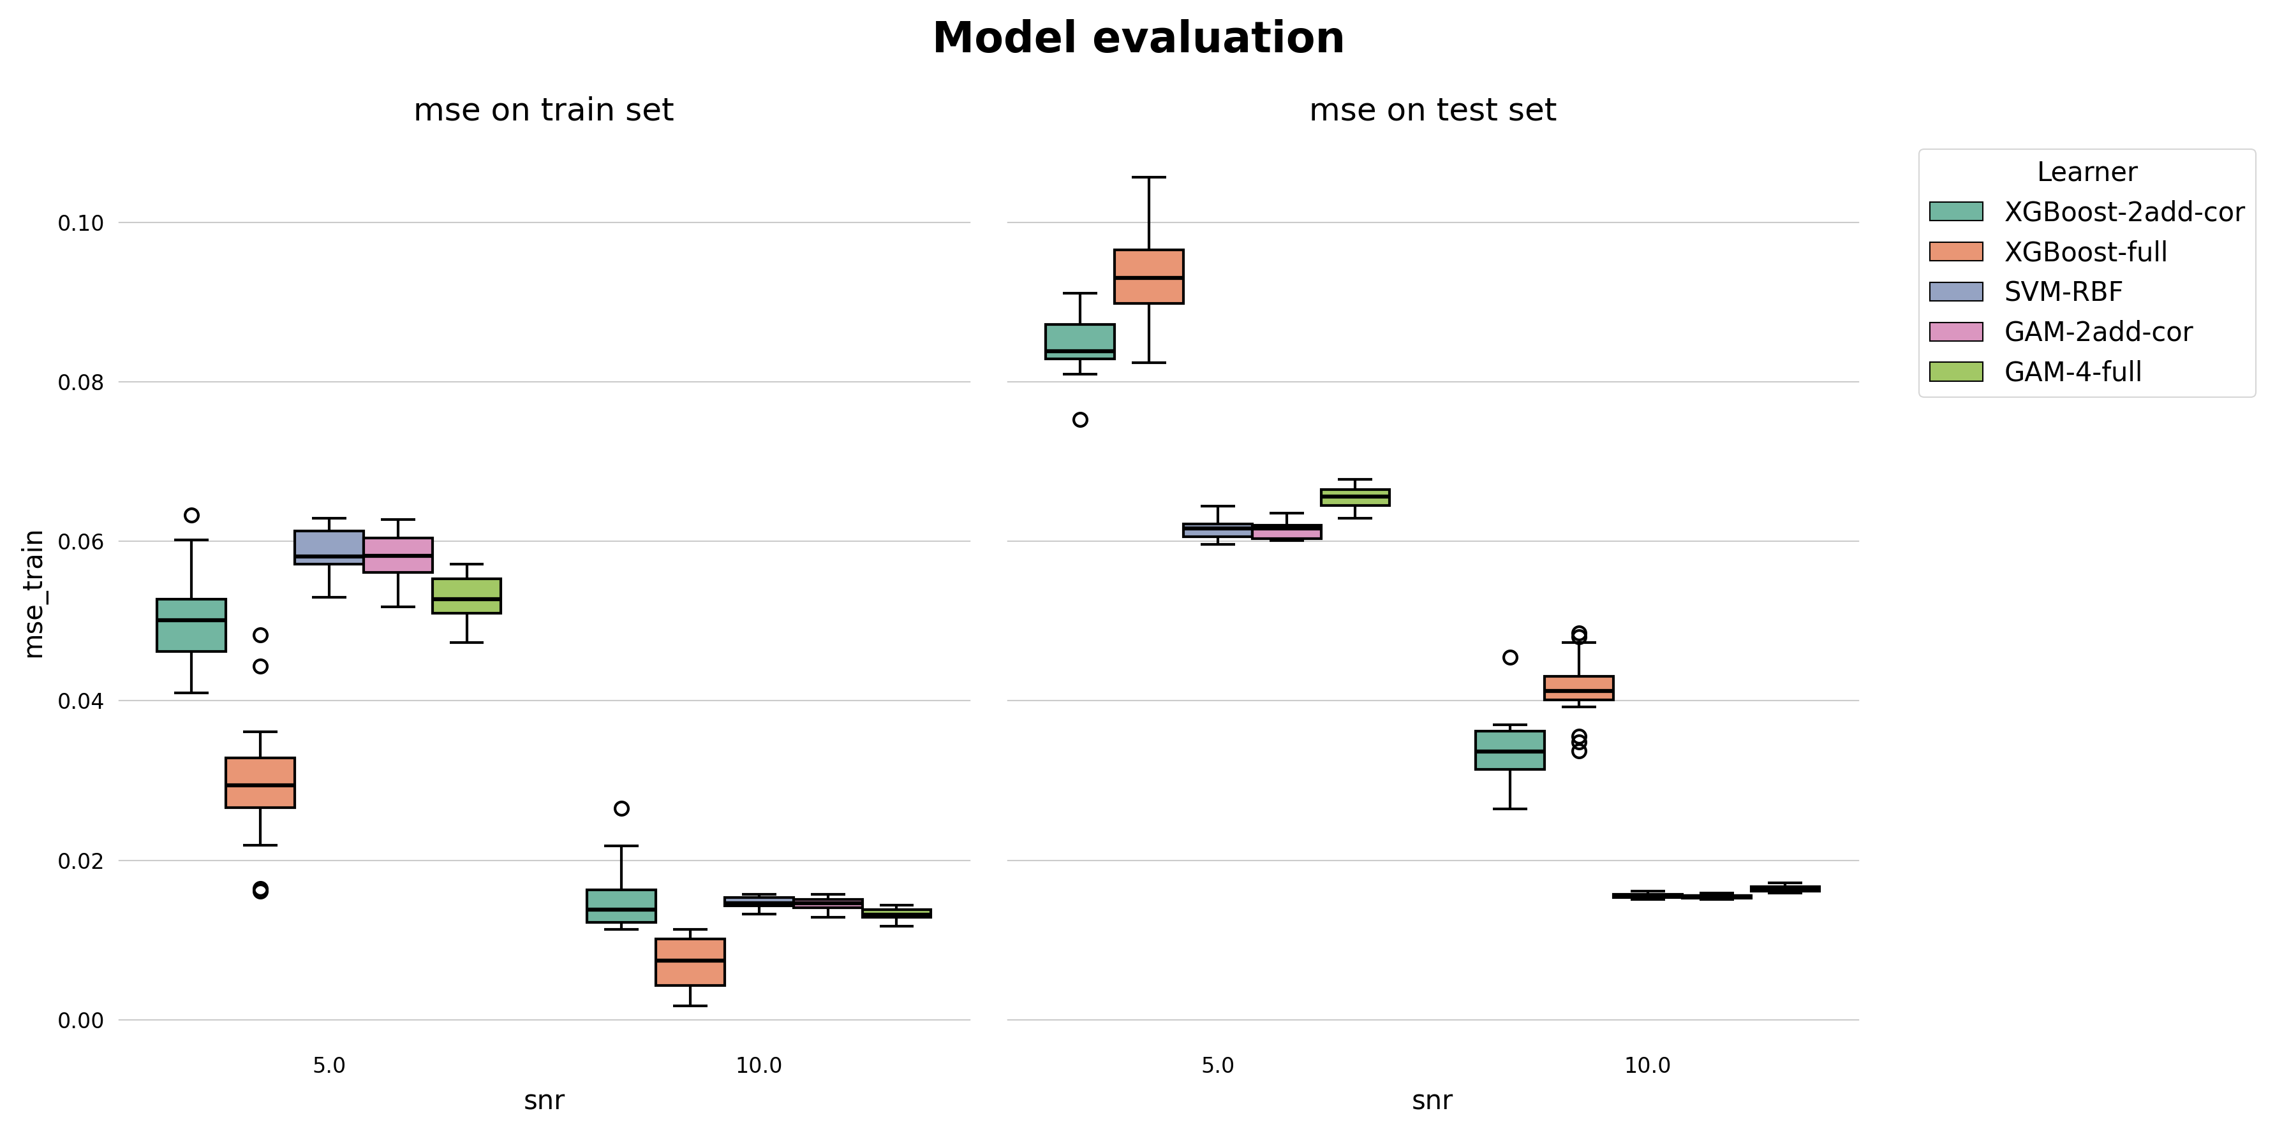
Model Performance [MSE]

Slide 8
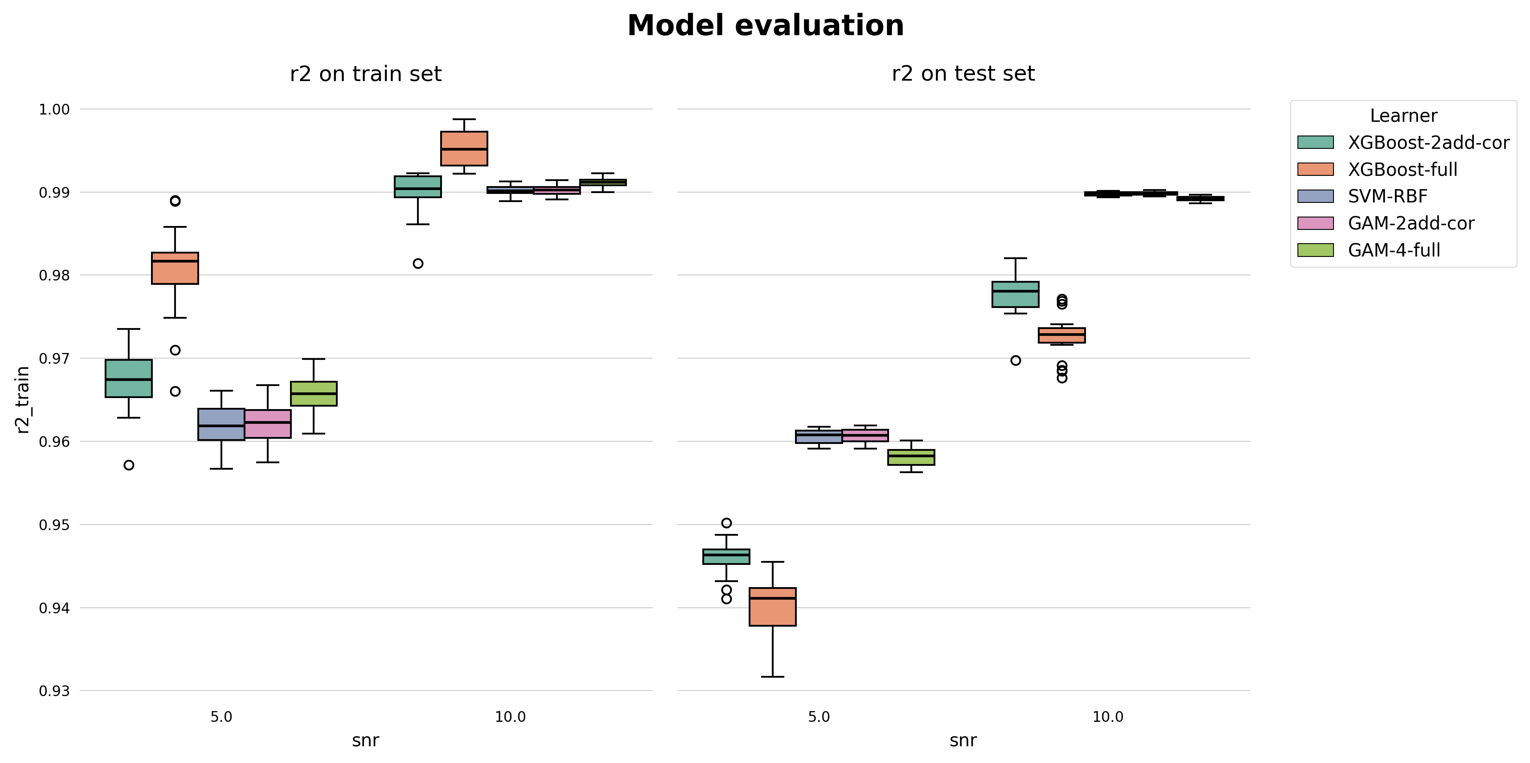
Model Performance [R2]

Slide 9
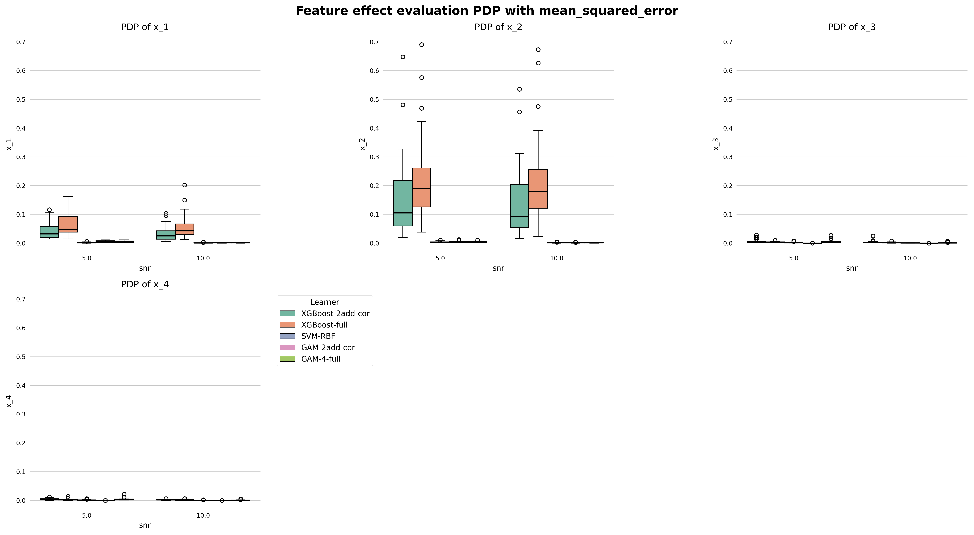
Feature Effect Error [PDP]

Slide 10
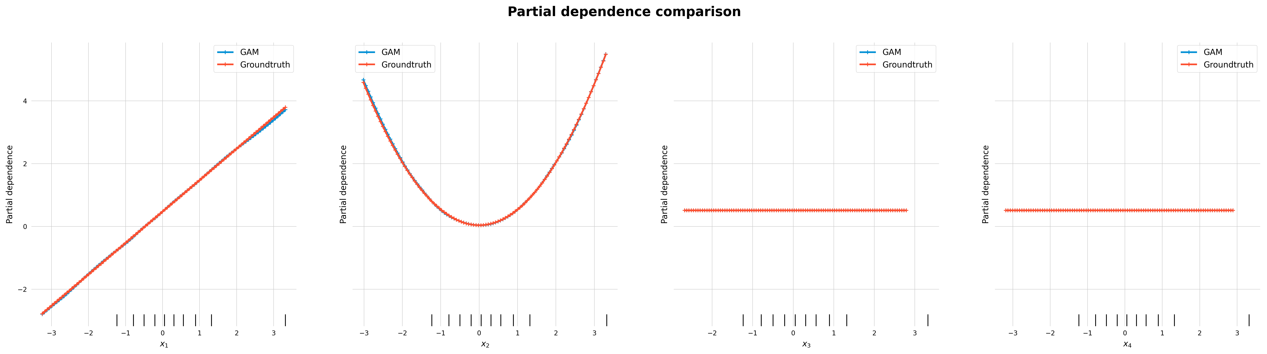
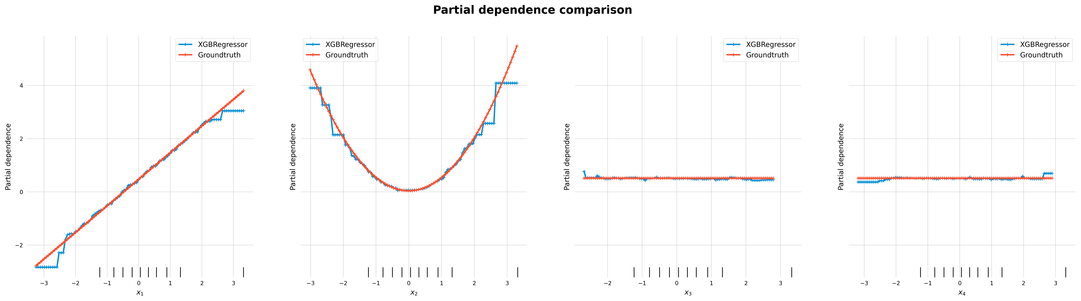
Feature Effect Examples [PDP]
Note: Feature effects are not centered in the plots

Slide 11
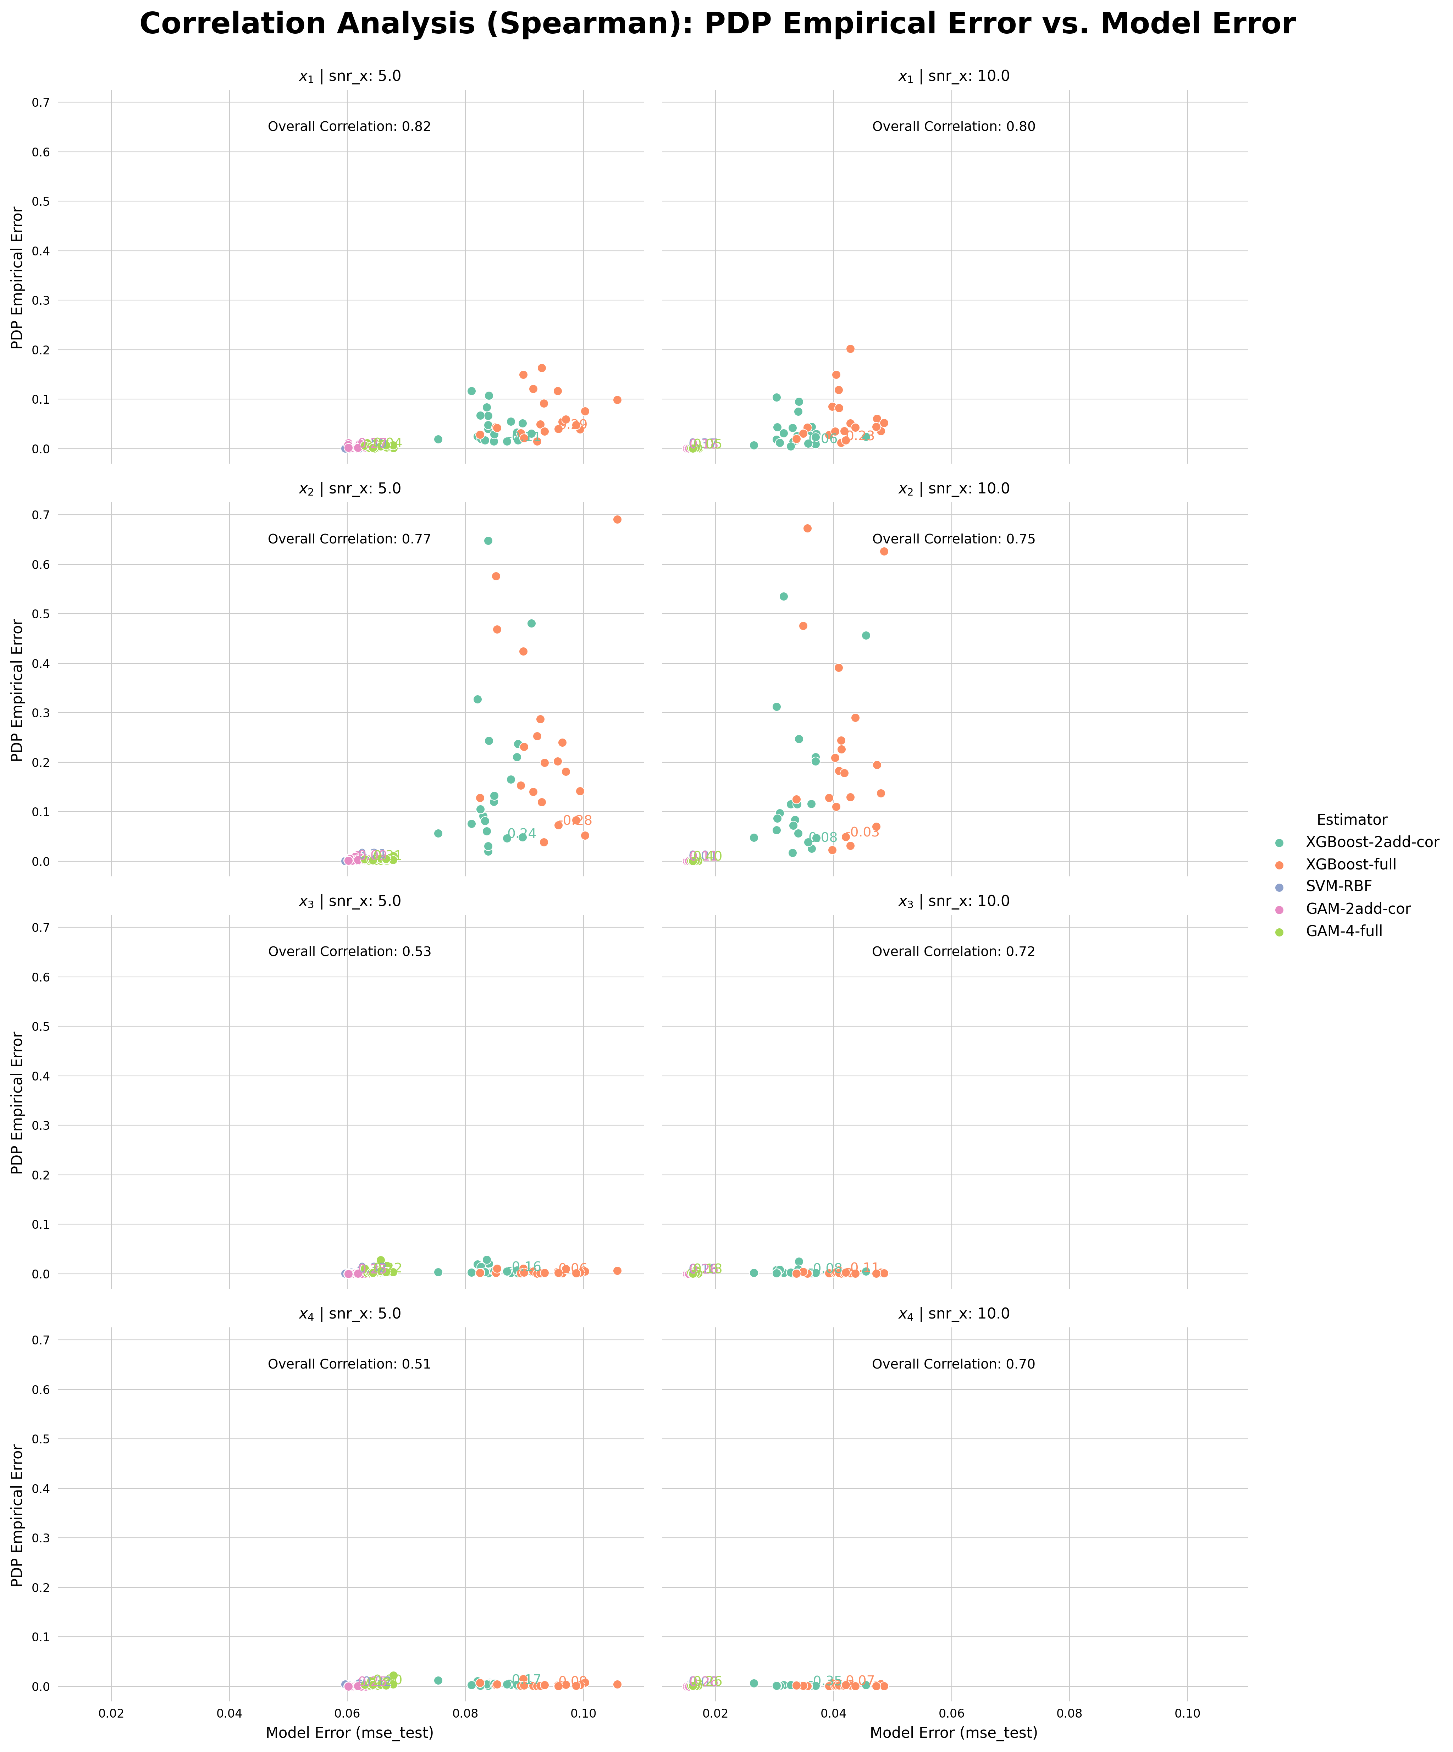
Correlation Analysis [PDP]
feature | snr | model | correlation
x_1 | 5.0 | Overall | 0.820078
 |  | XGBoost-2add-cor | -0.109774
 |  | XGBoost-full | 0.288722
 |  | SVM-RBF | 0.497744
 |  | GAM-2add-cor | 0.269173
 |  | GAM-4-full | 0.042105
 | 10.0 | Overall | 0.796376
 |  | XGBoost-2add-cor | 0.063158
 |  | XGBoost-full | 0.228571
 |  | SVM-RBF | 0.366917
 |  | GAM-2add-cor | 0.181955
 |  | GAM-4-full | 0.046617
x_2 | 5.0 | Overall | 0.768449
 |  | XGBoost-2add-cor | 0.239098
 |  | XGBoost-full | -0.276692
 |  | SVM-RBF | 0.209023
 |  | GAM-2add-cor | 0.090226
 |  | GAM-4-full | 0.305263
 | 10.0 | Overall | 0.749511
 |  | XGBoost-2add-cor | 0.082707
 |  | XGBoost-full | -0.030075
 |  | SVM-RBF | 0.009023
 |  | GAM-2add-cor | 0.114286
 |  | GAM-4-full | 0.398496
x_3 | 5.0 | Overall | 0.526613
 |  | XGBoost-2add-cor | -0.163910
 |  | XGBoost-full | 0.057143
 |  | SVM-RBF | 0.323308
 |  | GAM-2add-cor | 0.248120
 |  | GAM-4-full | 0.222556
 | 10.0 | Overall | 0.720600
 |  | XGBoost-2add-cor | -0.081203
 |  | XGBoost-full | -0.111278
 |  | SVM-RBF | 0.175940
 |  | GAM-2add-cor | 0.260150
 |  | GAM-4-full | 0.177444
x_4 | 5.0 | Overall | 0.513075
 |  | XGBoost-2add-cor | -0.172932
 |  | XGBoost-full | 0.093233
 |  | SVM-RBF | -0.320301
 |  | GAM-2add-cor | 0.248120
 |  | GAM-4-full | 0.303759
 | 10.0 | Overall | 0.702562
 |  | XGBoost-2add-cor | -0.347368
 |  | XGBoost-full | 0.070677
 |  | SVM-RBF | 0.004511
 |  | GAM-2add-cor | 0.260150
 |  | GAM-4-full | 0.255639

Slide 12
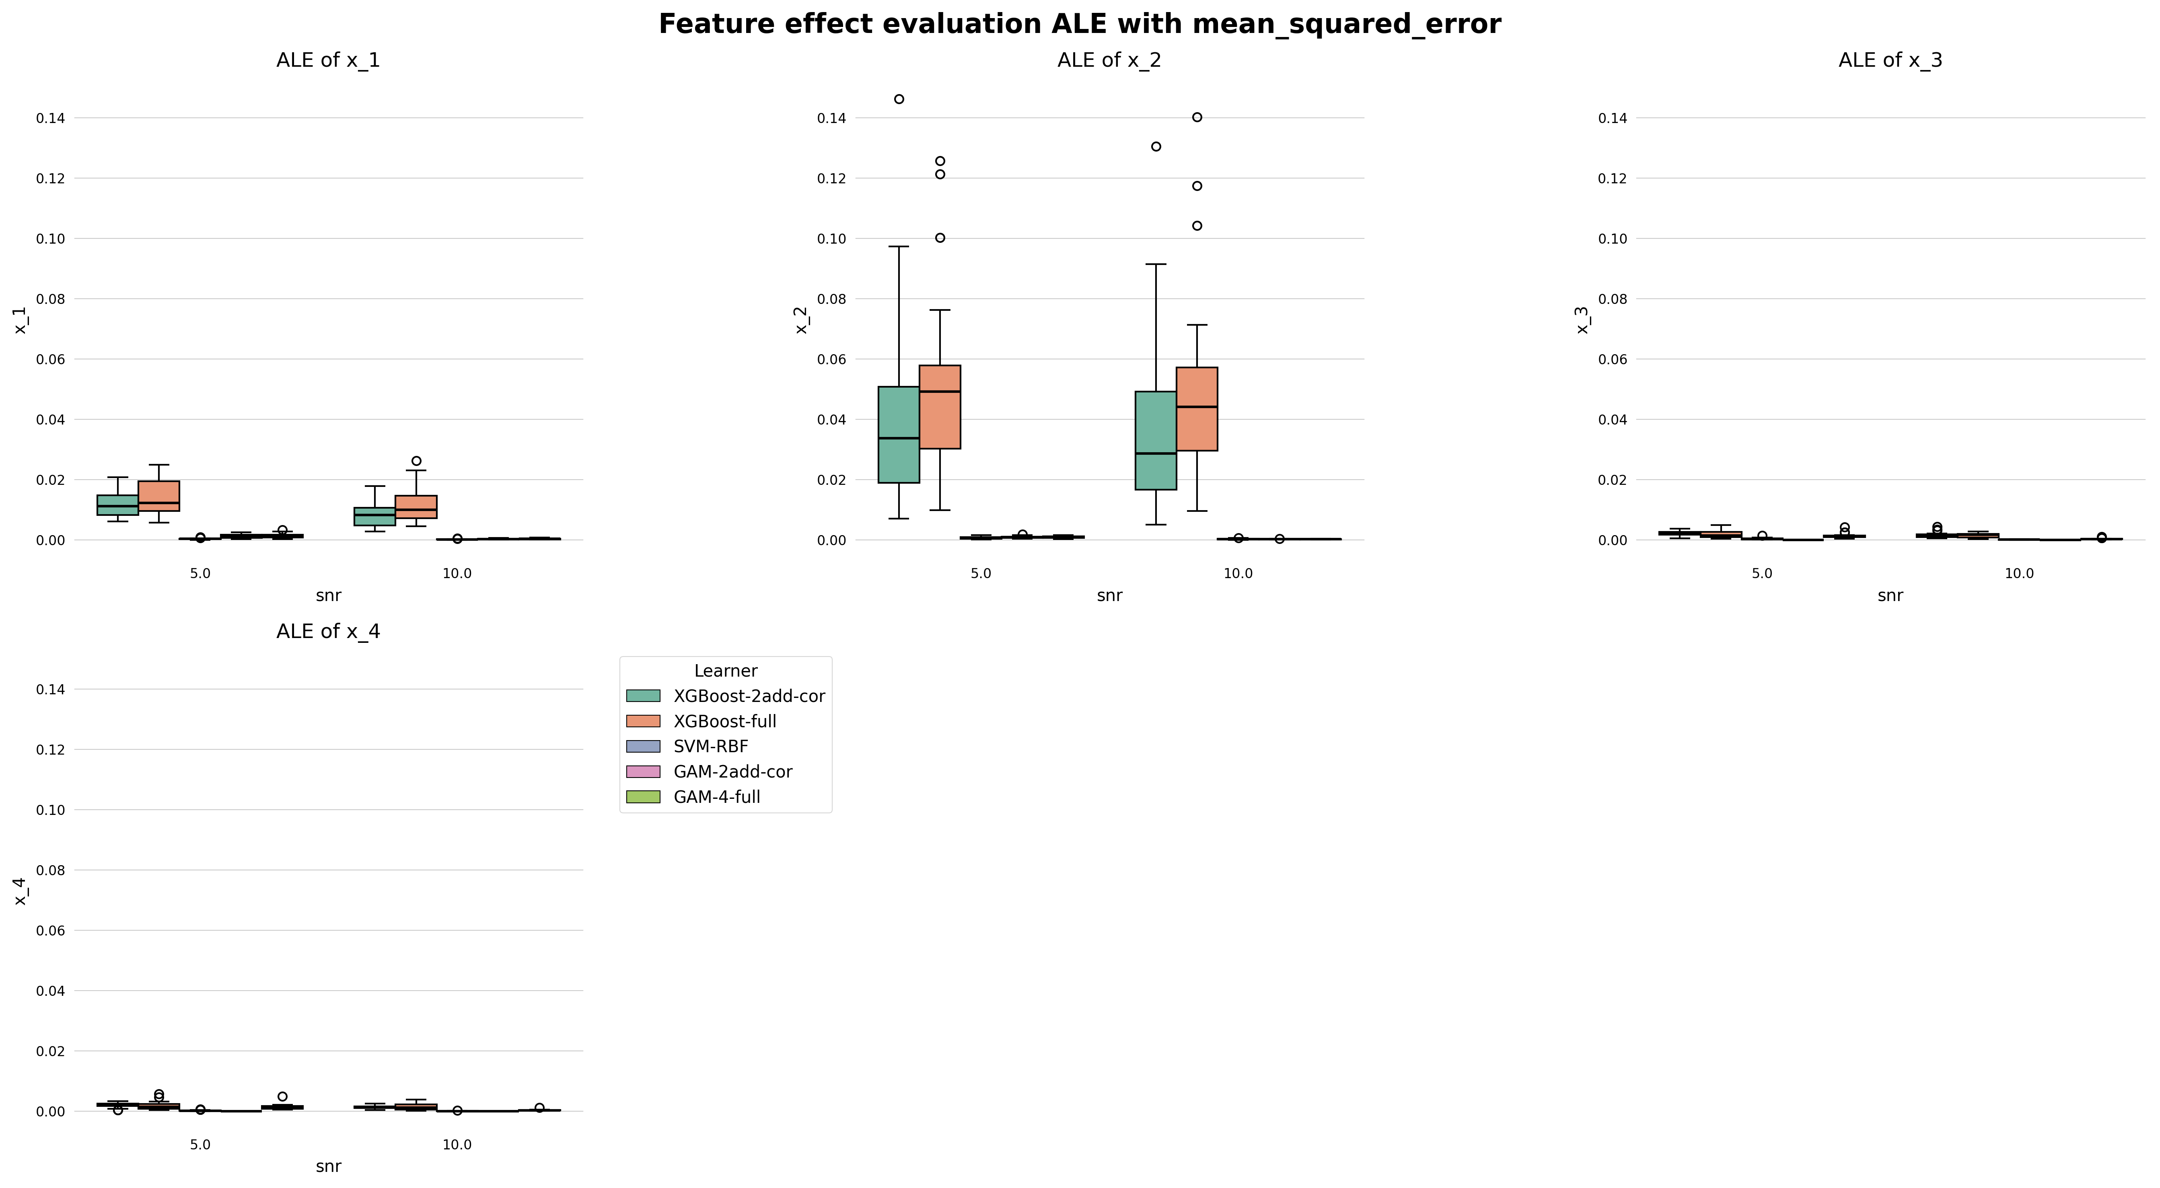
Feature Effect Error [ALE]

Slide 13
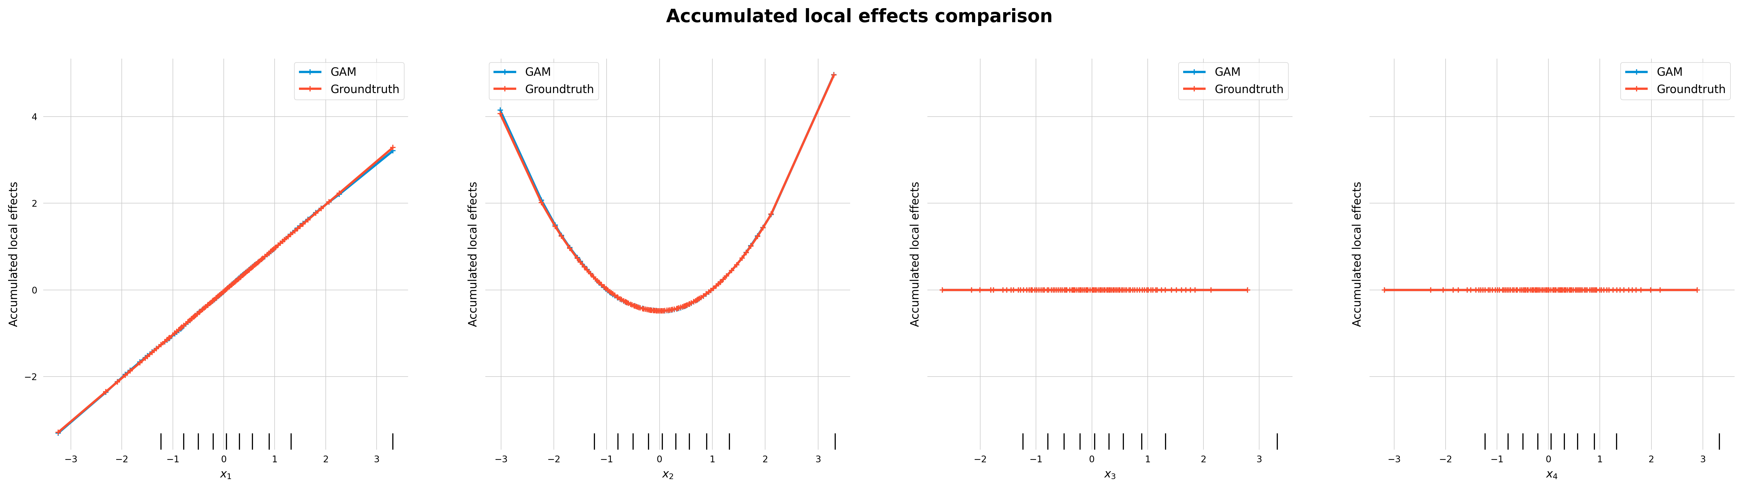
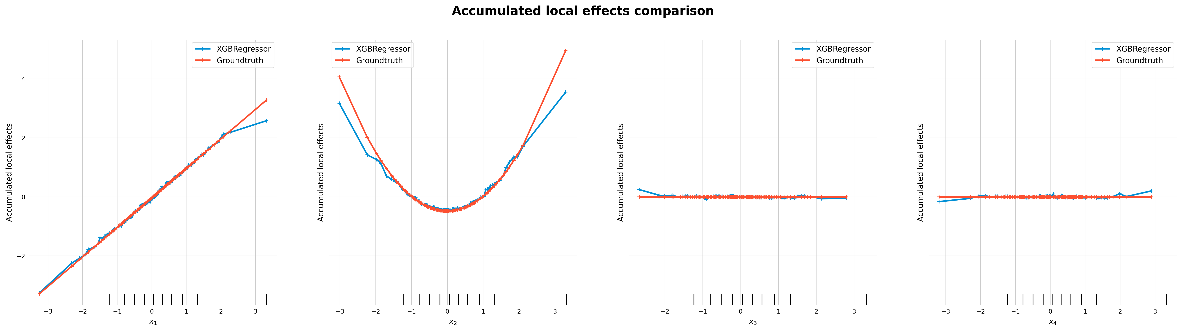
Feature Effect Examples [ALE]
Limited comparability to PDP: intervals not equidistant

Slide 14
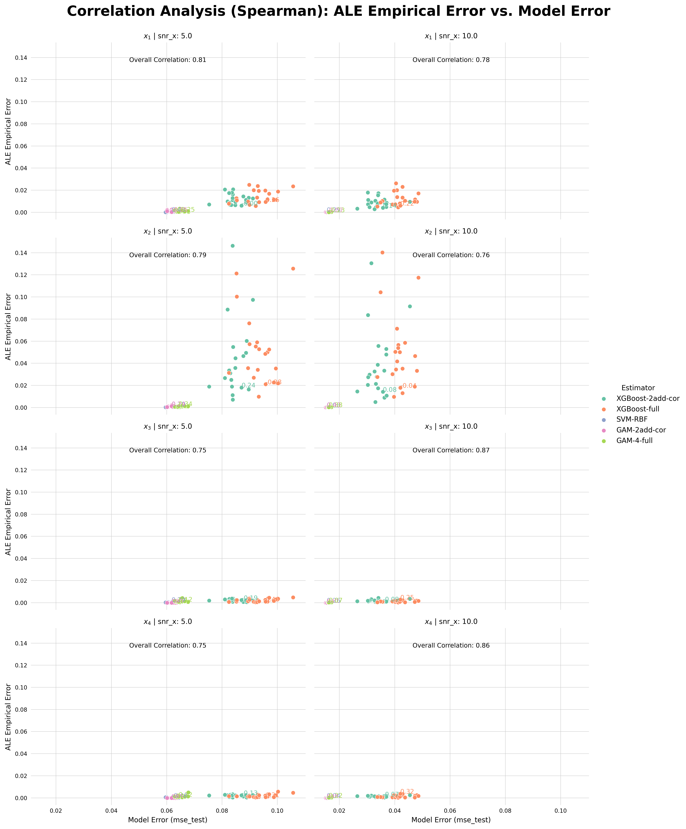
feature | snr | model | correlation
x_1 | 5.0 | Overall | 0.811029
 |  | XGBoost-2add-cor | -0.004511
 |  | XGBoost-full | 0.261654
 |  | SVM-RBF | 0.434586
 |  | GAM-2add-cor | -0.052632
 |  | GAM-4-full | -0.245113
 | 10.0 | Overall | 0.781674
 |  | XGBoost-2add-cor | 0.135338
 |  | XGBoost-full | 0.215038
 |  | SVM-RBF | 0.285714
 |  | GAM-2add-cor | -0.069173
 |  | GAM-4-full | -0.230075
x_2 | 5.0 | Overall | 0.794059
 |  | XGBoost-2add-cor | 0.236090
 |  | XGBoost-full | -0.276692
 |  | SVM-RBF | 0.204511
 |  | GAM-2add-cor | 0.239098
 |  | GAM-4-full | 0.344361
 | 10.0 | Overall | 0.763900
 |  | XGBoost-2add-cor | 0.078195
 |  | XGBoost-full | -0.043609
 |  | SVM-RBF | 0.034586
 |  | GAM-2add-cor | 0.401504
 |  | GAM-4-full | 0.378947
x_3 | 5.0 | Overall | 0.750134
 |  | XGBoost-2add-cor | -0.189474
 |  | XGBoost-full | 0.457143
 |  | SVM-RBF | 0.287218
 |  | GAM-2add-cor | NaN
 |  | GAM-4-full | 0.124812
 | 10.0 | Overall | 0.867266
 |  | XGBoost-2add-cor | -0.091729
 |  | XGBoost-full | 0.254135
 |  | SVM-RBF | 0.255639
 |  | GAM-2add-cor | NaN
 |  | GAM-4-full | 0.069173
x_4 | 5.0 | Overall | 0.747893
 |  | XGBoost-2add-cor | -0.132331
 |  | XGBoost-full | 0.311278
 |  | SVM-RBF | -0.464662
 |  | GAM-2add-cor | NaN
 |  | GAM-4-full | 0.315789
 | 10.0 | Overall | 0.864591
 |  | XGBoost-2add-cor | -0.073684
 |  | XGBoost-full | 0.320301
 |  | SVM-RBF | 0.043609
 |  | GAM-2add-cor | NaN
 |  | GAM-4-full | 0.221053
Correlation Analysis [ALE]

Slide 15
Results Combined Scenario

Slide 16
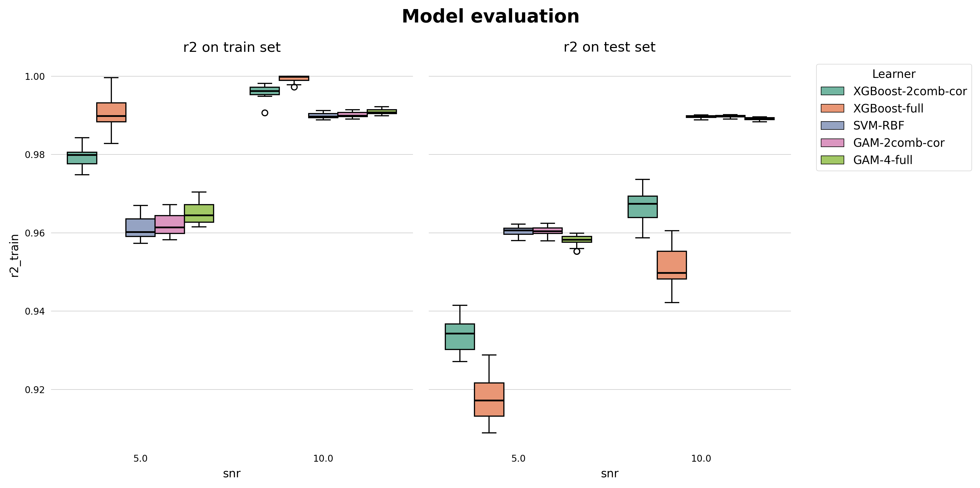
Model Performance Combined [R2]

Slide 17
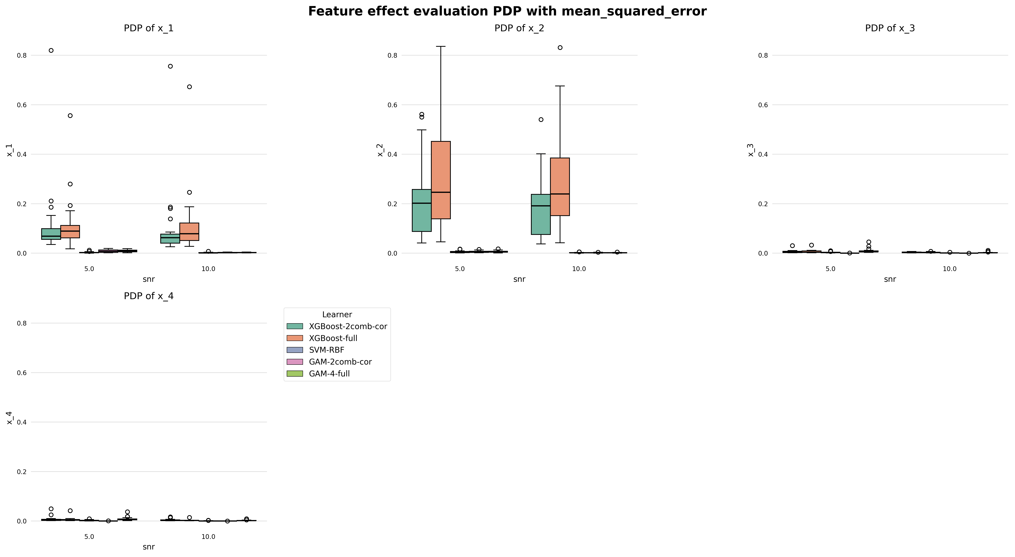
Feature Effect Error Combined [PDP]

Slide 18
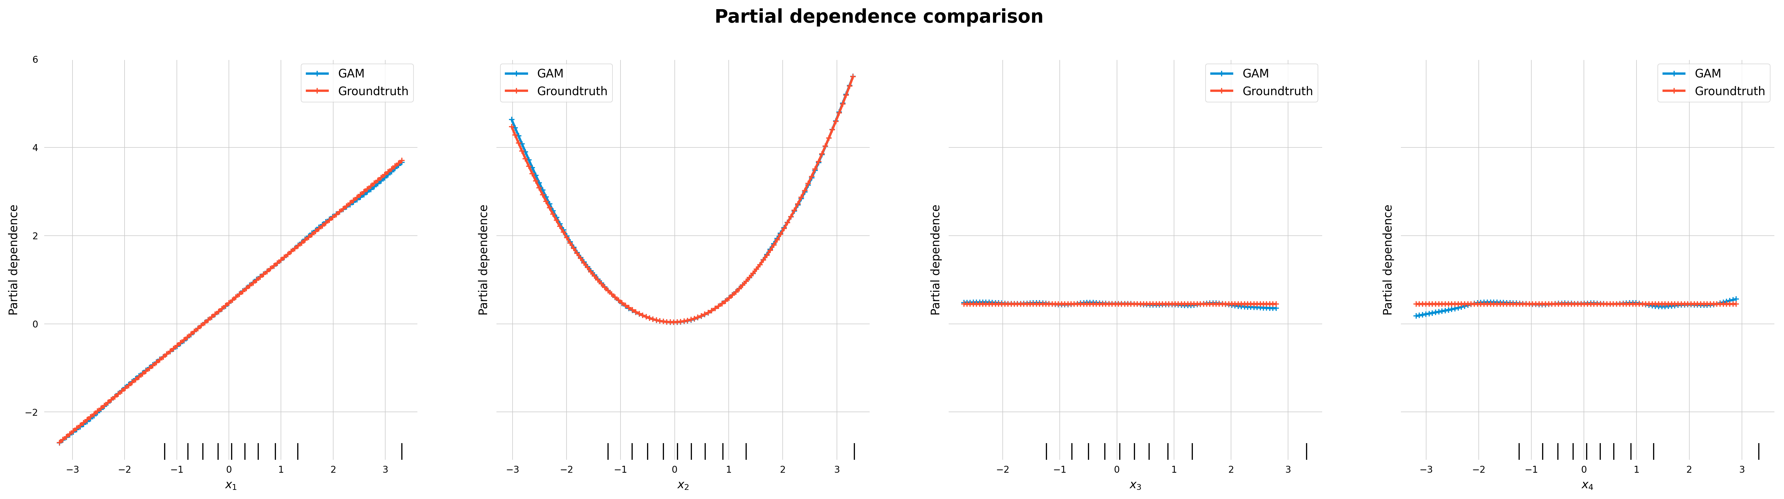
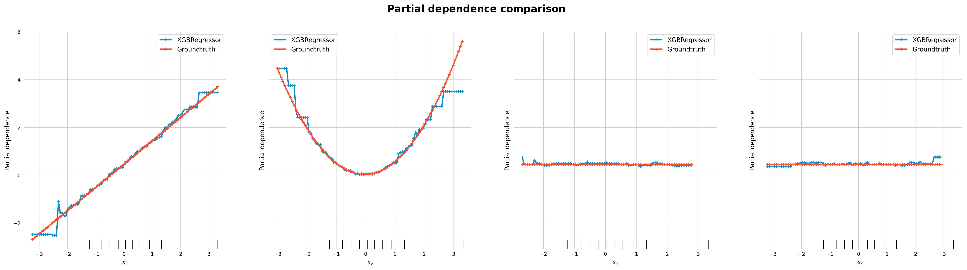
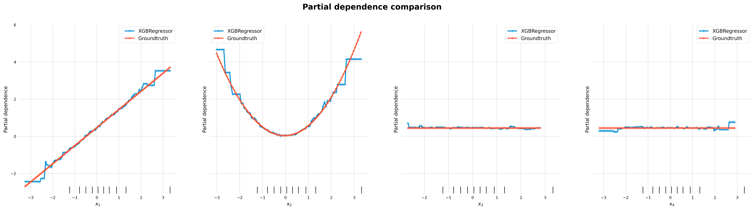
full
full
correctly specified

Slide 19
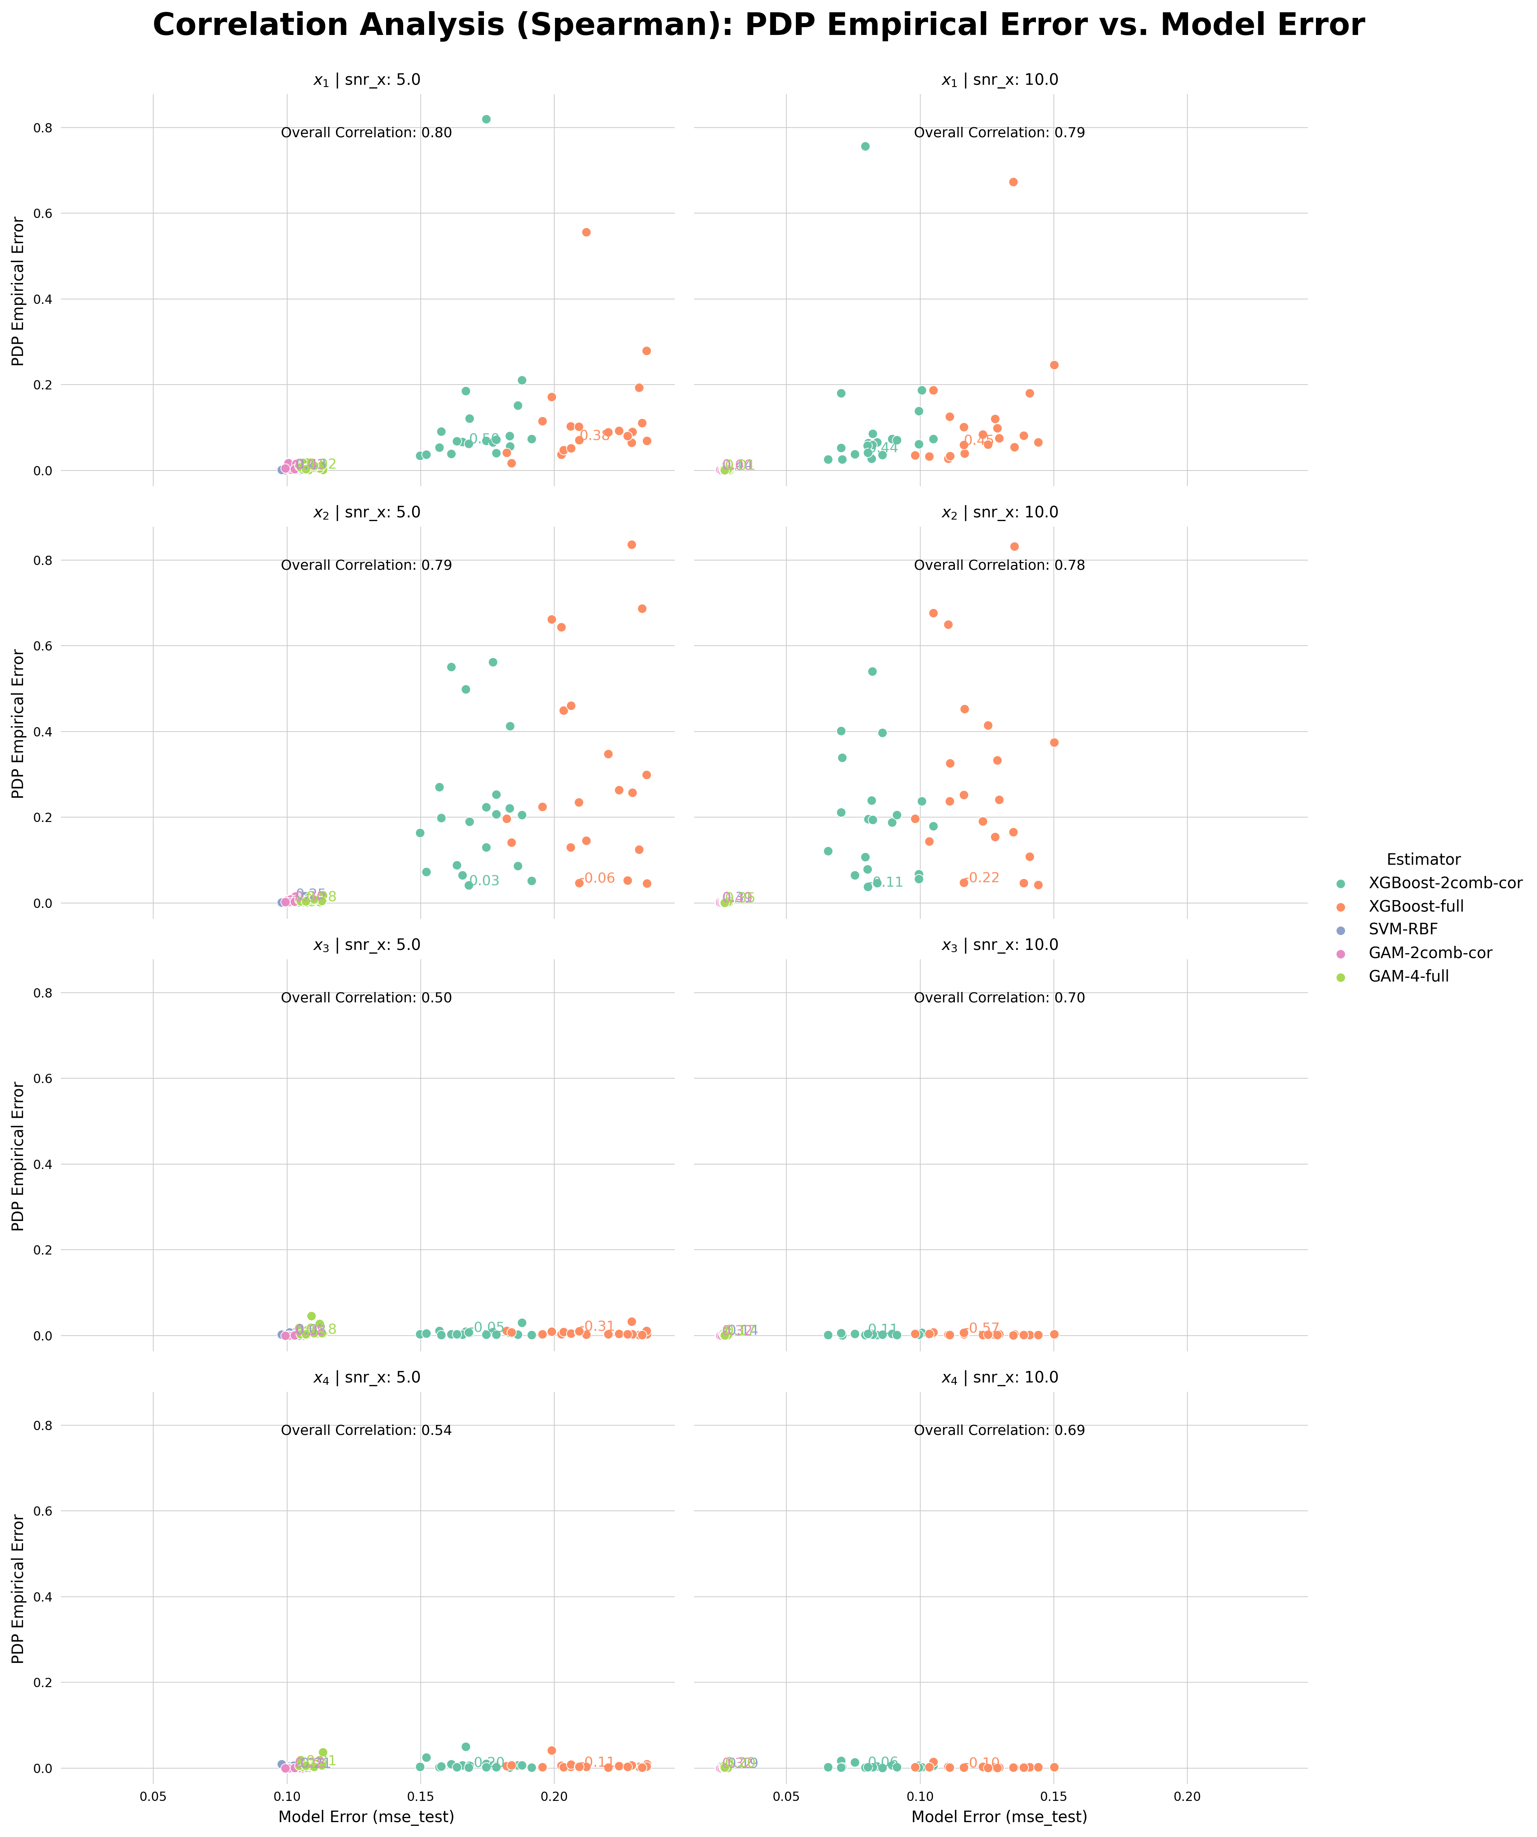
Correlation Analysis Combined [PDP]
feature | snr | model | correlation
x_1 | 5.0 | Overall | 0.802952
 |  | XGBoost-2comb-cor | 0.502256
 |  | XGBoost-full | 0.375940
 |  | SVM-RBF | 0.428571
 |  | GAM-2comb-cor | 0.009023
 |  | GAM-4-full | 0.024060
 | 10.0 | Overall | 0.791071
 |  | XGBoost-2comb-cor | 0.440602
 |  | XGBoost-full | 0.454135
 |  | SVM-RBF | 0.440602
 |  | GAM-2comb-cor | 0.001504
 |  | GAM-4-full | 0.009023
x_2 | 5.0 | Overall | 0.787375
 |  | XGBoost-2comb-cor | 0.027068
 |  | XGBoost-full | -0.063158
 |  | SVM-RBF | 0.254135
 |  | GAM-2comb-cor | 0.303759
 |  | GAM-4-full | 0.278195
 | 10.0 | Overall | 0.782022
 |  | XGBoost-2comb-cor | -0.108271
 |  | XGBoost-full | -0.218045
 |  | SVM-RBF | 0.308271
 |  | GAM-2comb-cor | 0.485714
 |  | GAM-4-full | 0.353383
x_3 | 5.0 | Overall | 0.501818
 |  | XGBoost-2comb-cor | -0.049624
 |  | XGBoost-full | -0.311278
 |  | SVM-RBF | 0.033083
 |  | GAM-2comb-cor | 0.282707
 |  | GAM-4-full | 0.178947
 | 10.0 | Overall | 0.697930
 |  | XGBoost-2comb-cor | 0.105263
 |  | XGBoost-full | -0.568421
 |  | SVM-RBF | -0.144361
 |  | GAM-2comb-cor | 0.320301
 |  | GAM-4-full | 0.169925
x_4 | 5.0 | Overall | 0.539994
 |  | XGBoost-2comb-cor | -0.195489
 |  | XGBoost-full | -0.109774
 |  | SVM-RBF | -0.210526
 |  | GAM-2comb-cor | 0.282707
 |  | GAM-4-full | 0.306767
 | 10.0 | Overall | 0.688833
 |  | XGBoost-2comb-cor | 0.060150
 |  | XGBoost-full | -0.096241
 |  | SVM-RBF | -0.192481
 |  | GAM-2comb-cor | 0.320301
 |  | GAM-4-full | 0.201504

Slide 20
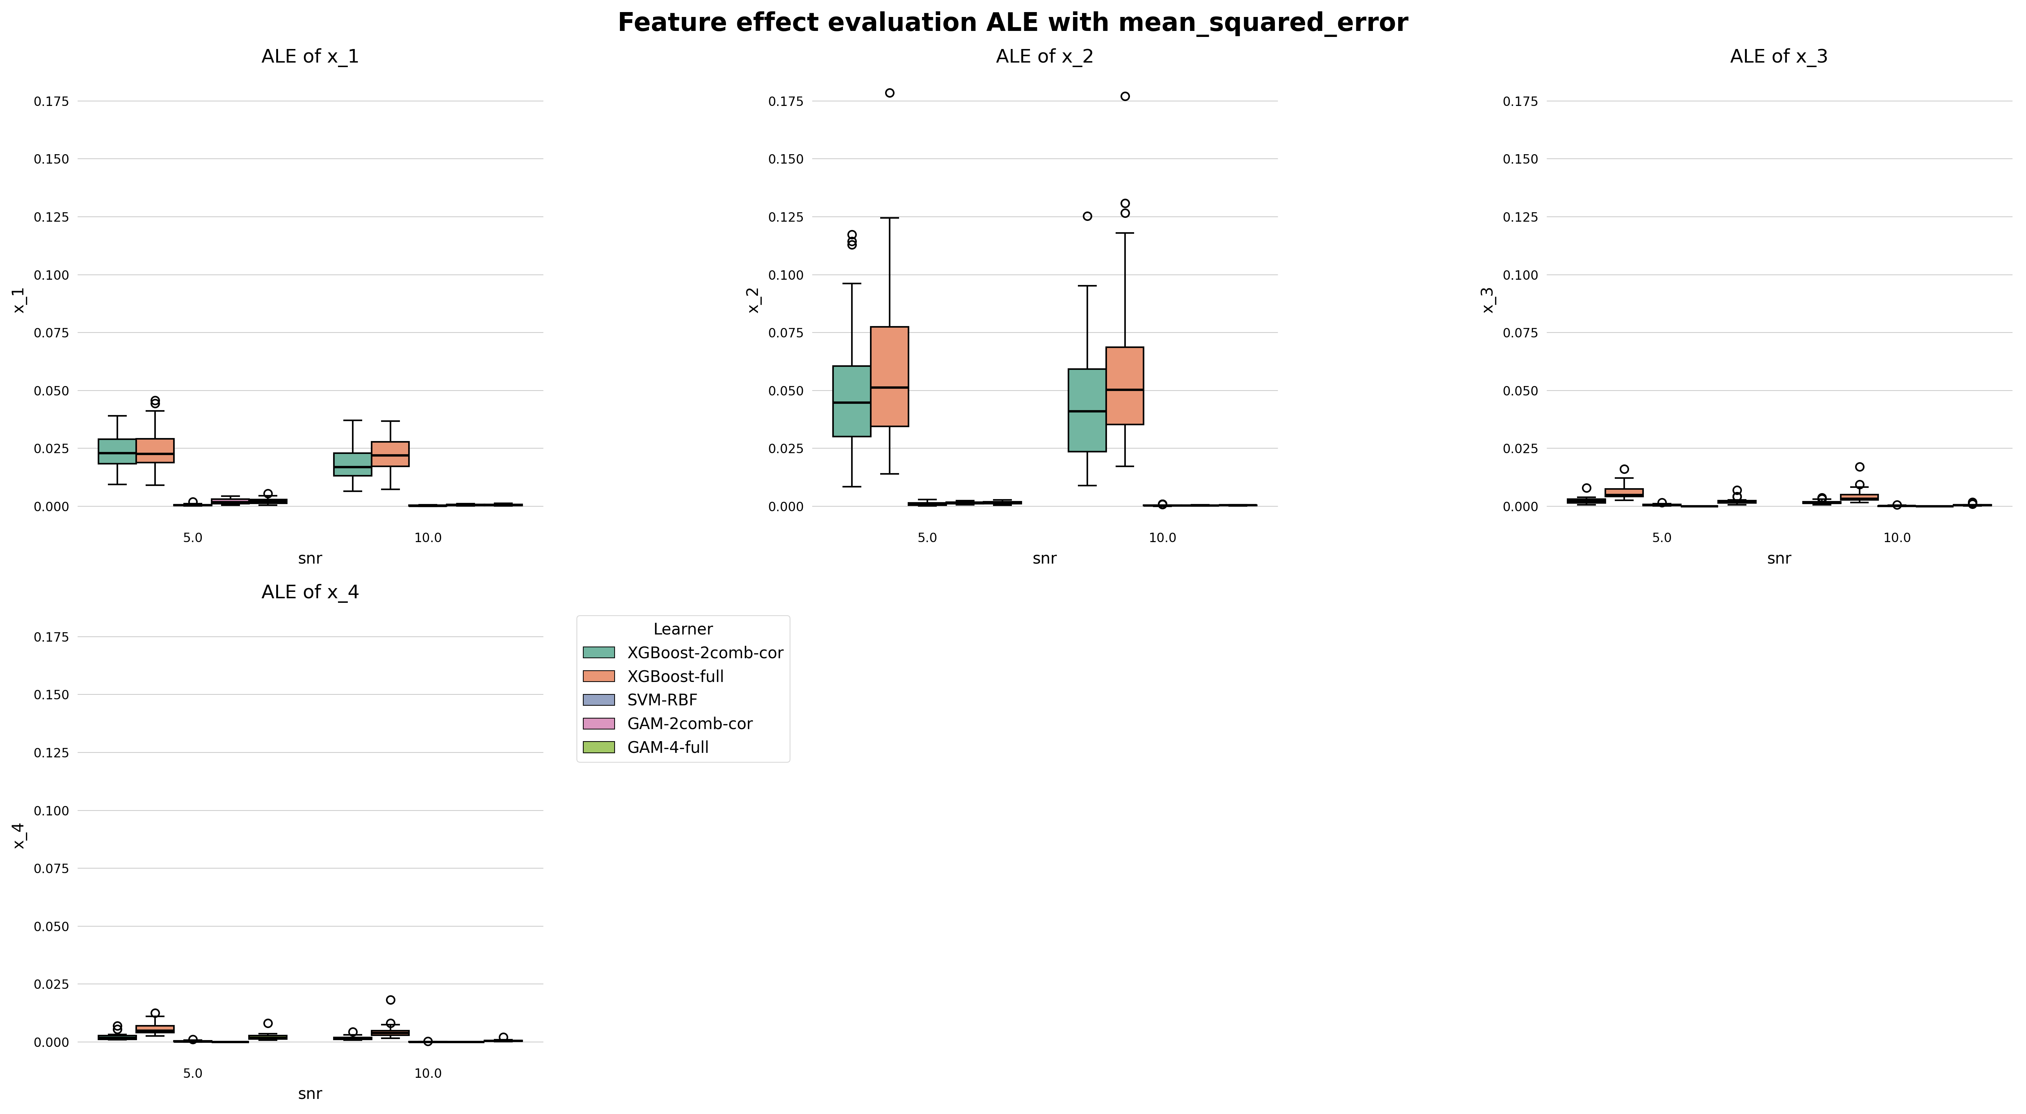
Feature Effect Error Combined [ALE]

Slide 21
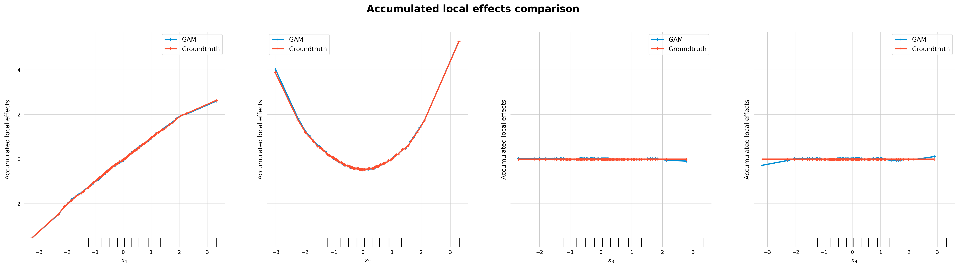
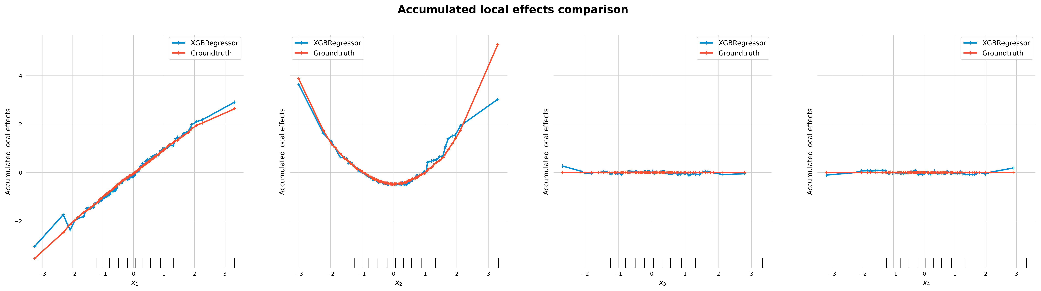
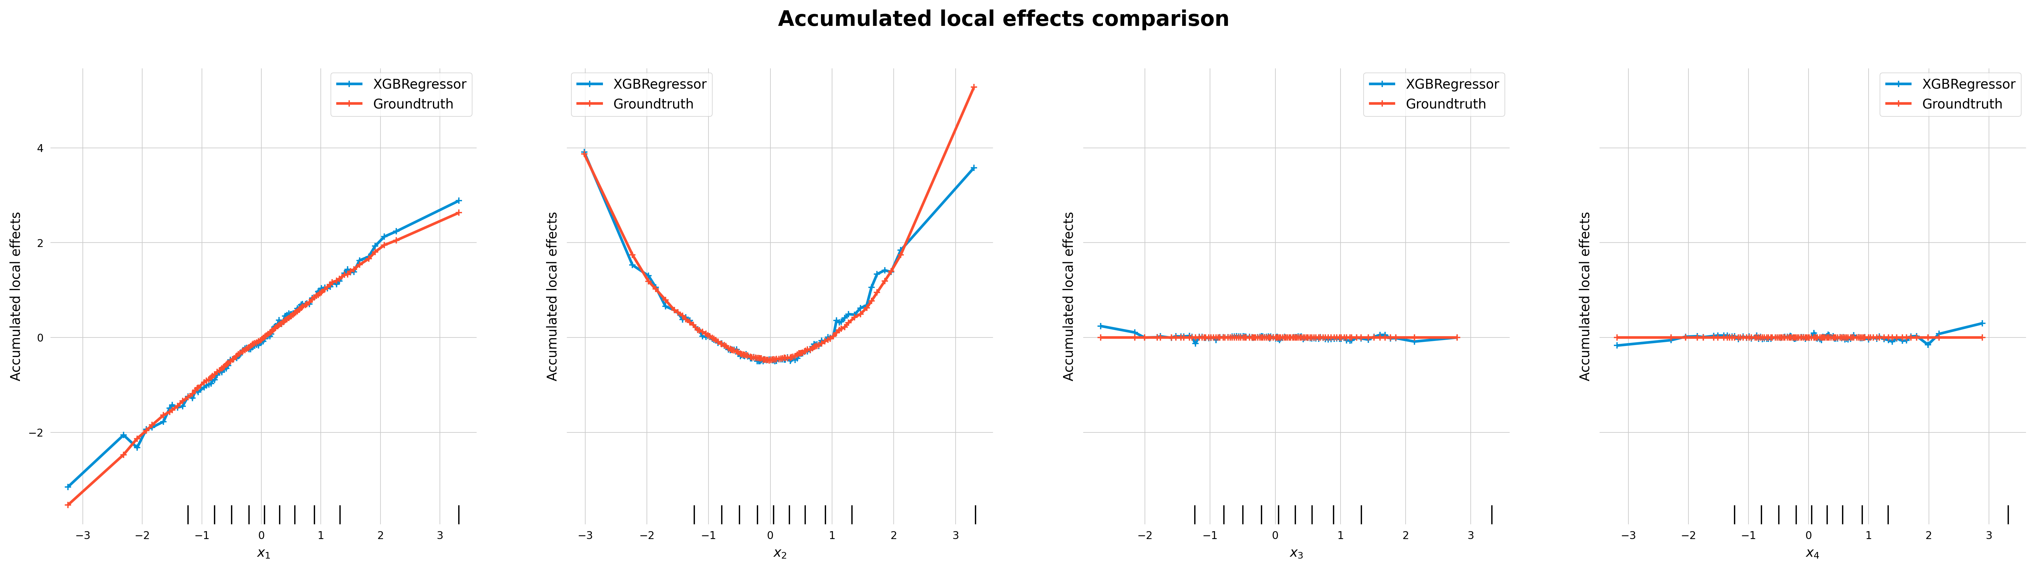
full
full
correctly specified

Slide 22
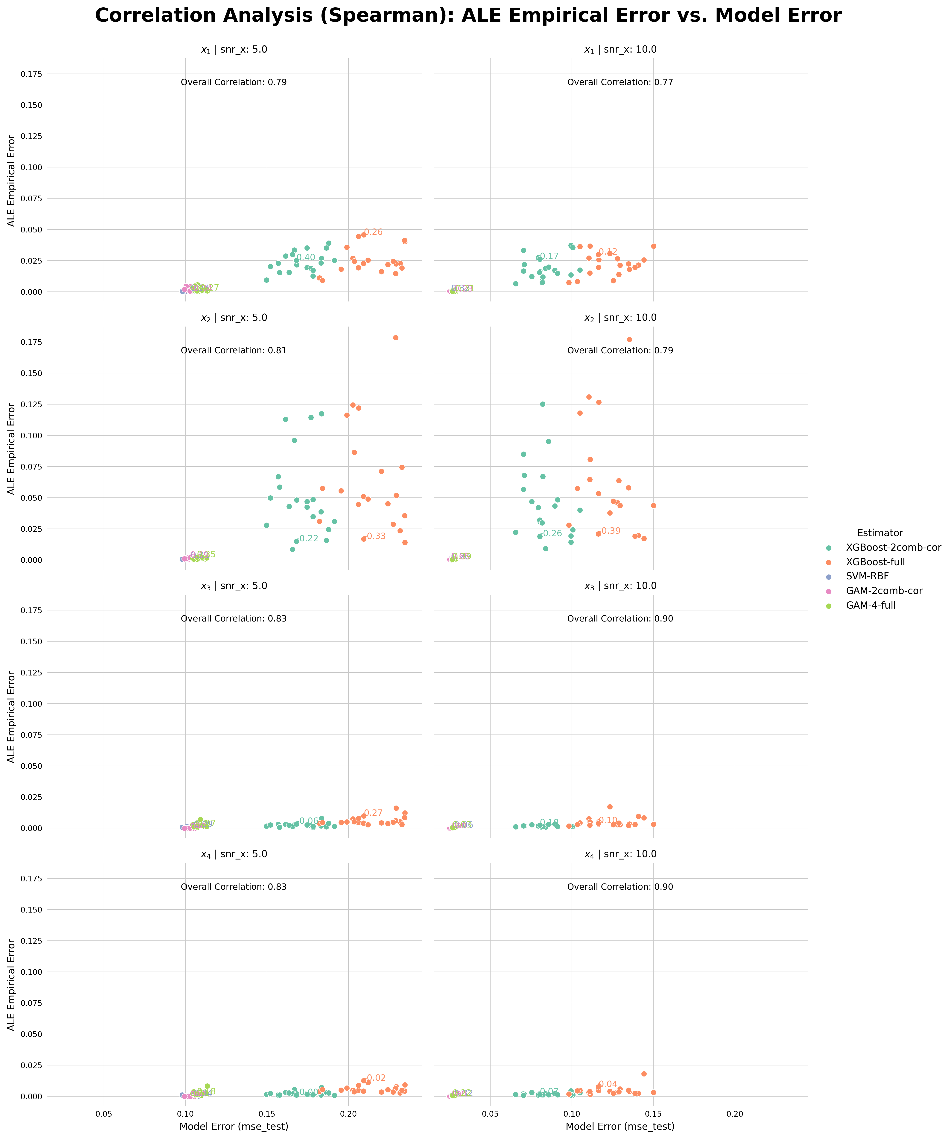
Correlation Analysis Combined [ALE]
feature | snr | model | correlation
x_1 | 5.0 | Overall | 0.791431
 |  | XGBoost-2comb-cor | 0.395489
 |  | XGBoost-full | 0.255639
 |  | SVM-RBF | 0.243609
 |  | GAM-2comb-cor | -0.240602
 |  | GAM-4-full | -0.270677
 | 10.0 | Overall | 0.770285
 |  | XGBoost-2comb-cor | 0.171429
 |  | XGBoost-full | 0.117293
 |  | SVM-RBF | 0.324812
 |  | GAM-2comb-cor | -0.225564
 |  | GAM-4-full | -0.309774
x_2 | 5.0 | Overall | 0.806613
 |  | XGBoost-2comb-cor | -0.216541
 |  | XGBoost-full | -0.327820
 |  | SVM-RBF | 0.311278
 |  | GAM-2comb-cor | 0.493233
 |  | GAM-4-full | 0.347368
 | 10.0 | Overall | 0.794479
 |  | XGBoost-2comb-cor | -0.260150
 |  | XGBoost-full | -0.390977
 |  | SVM-RBF | 0.203008
 |  | GAM-2comb-cor | 0.645113
 |  | GAM-4-full | 0.390977
x_3 | 5.0 | Overall | 0.826262
 |  | XGBoost-2comb-cor | -0.064662
 |  | XGBoost-full | 0.272180
 |  | SVM-RBF | -0.093233
 |  | GAM-2comb-cor | NaN
 |  | GAM-4-full | 0.070677
 | 10.0 | Overall | 0.898757
 |  | XGBoost-2comb-cor | 0.103759
 |  | XGBoost-full | 0.102256
 |  | SVM-RBF | -0.057143
 |  | GAM-2comb-cor | NaN
 |  | GAM-4-full | 0.034586
x_4 | 5.0 | Overall | 0.830720
 |  | XGBoost-2comb-cor | -0.001504
 |  | XGBoost-full | -0.019549
 |  | SVM-RBF | -0.335338
 |  | GAM-2comb-cor | NaN
 |  | GAM-4-full | 0.178947
 | 10.0 | Overall | 0.901781
 |  | XGBoost-2comb-cor | 0.067669
 |  | XGBoost-full | 0.037594
 |  | SVM-RBF | -0.324812
 |  | GAM-2comb-cor | NaN
 |  | GAM-4-full | 0.218045

Slide 23
Next Steps

Slide 24
Next Steps
Fix grid calculation for ALE
Run remaining simulations
Create error-graph: What do we want to find out?
…

Slide 25
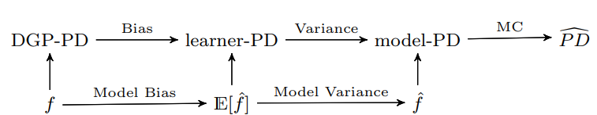
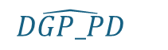
$$\hat{DGP_PD}$$
MC

Slide 26
Back-Up: Results Friedman1

Slide 27
Simulation Setting
Same setting as before, with the exception of the following points:
uses Frieman1 dataset as groundtruth:
5 standard-uniformly distributed, uncorrelated features (no additional noise features)
Friedman1 function: f(x) = 10 * sin(pi * x₁*x₂) + 20 * (x₃ - 0.5)² + 10 * x₄ + 5 * x₅ + e * N(0, 1)
Different models: RandomForest, XGBoost (full), SVM-RBF, GAM (correctly specified), ElasticNet

Slide 28
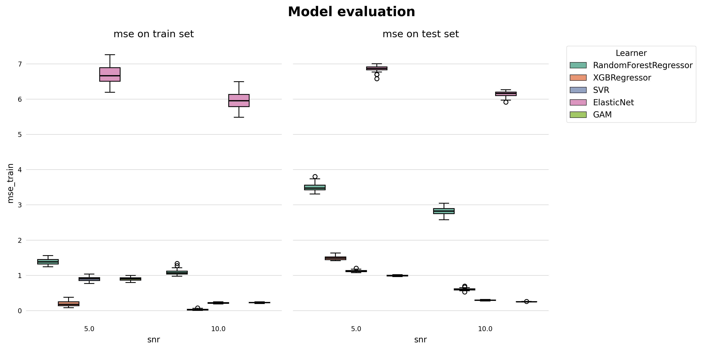
Model Results Friedman1

Slide 29
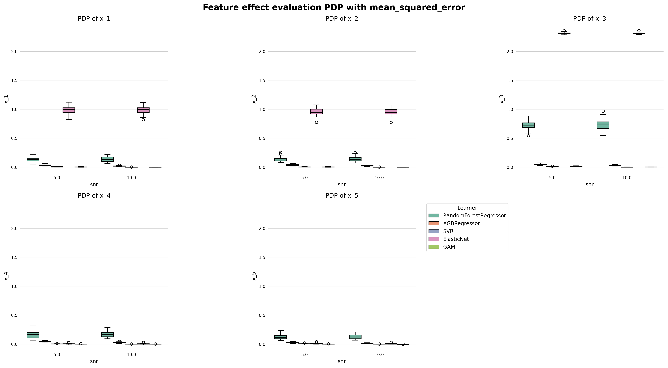
Feature Effect Error Friedman1 [PDP]

Slide 30
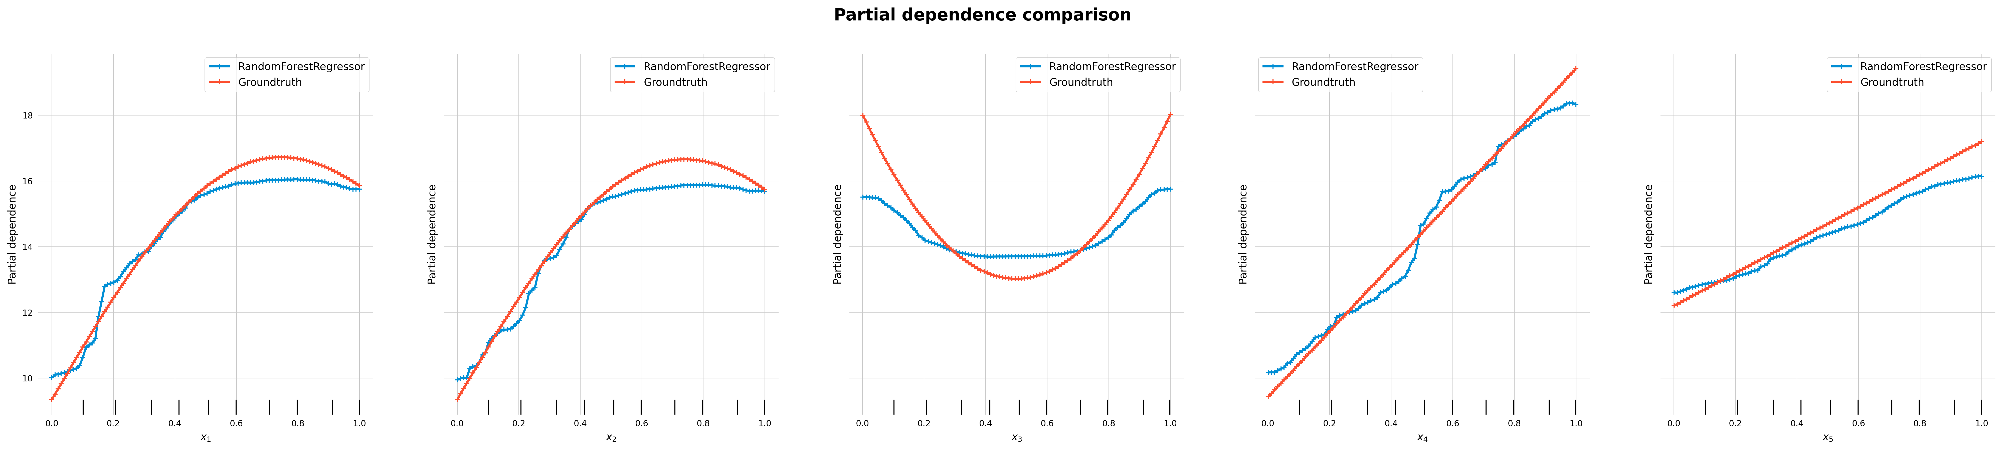
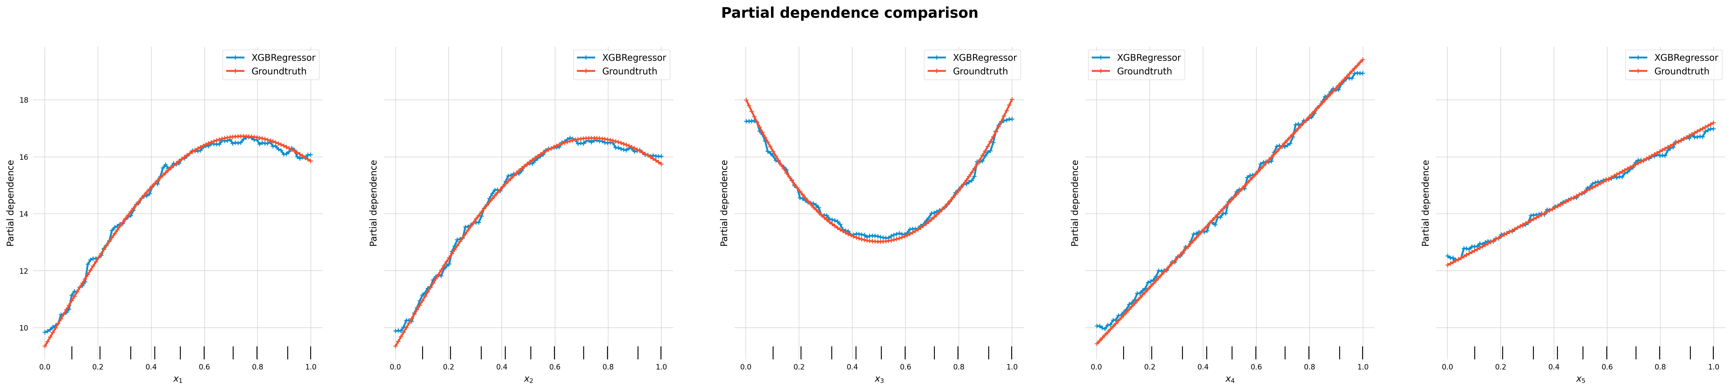
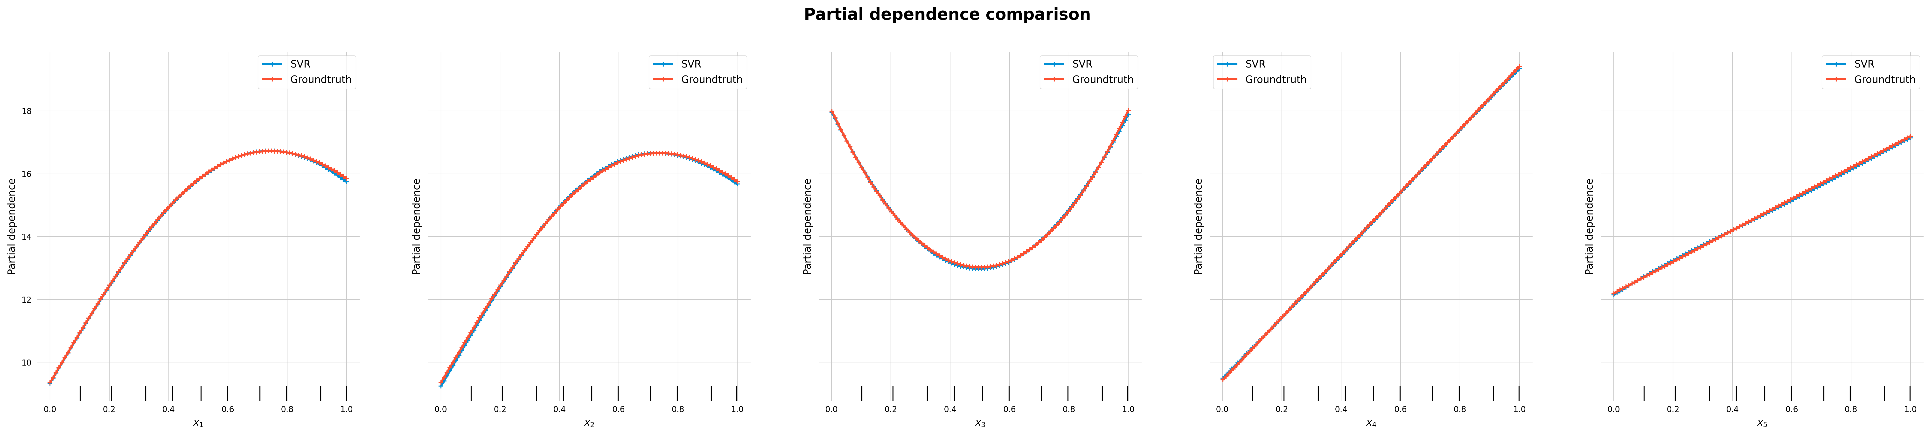

Slide 31
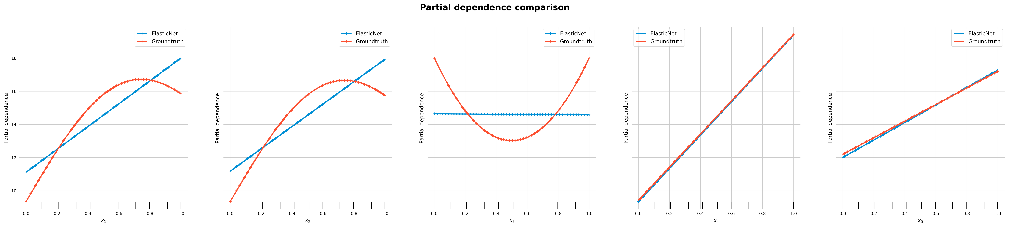
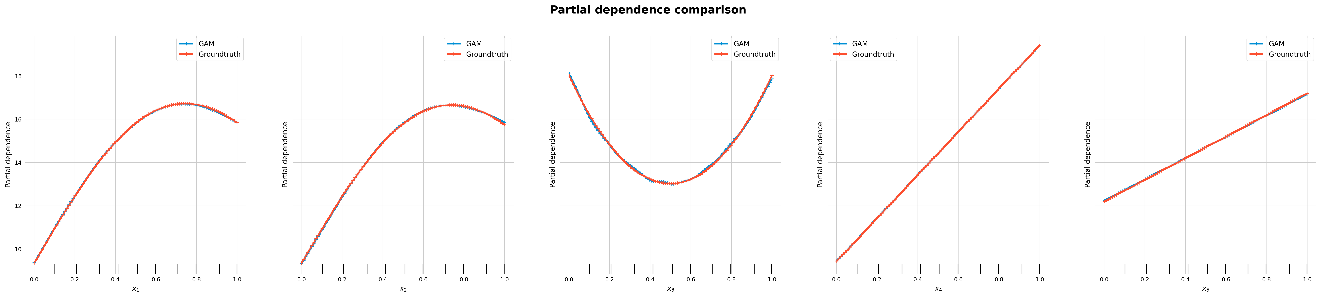

Slide 32
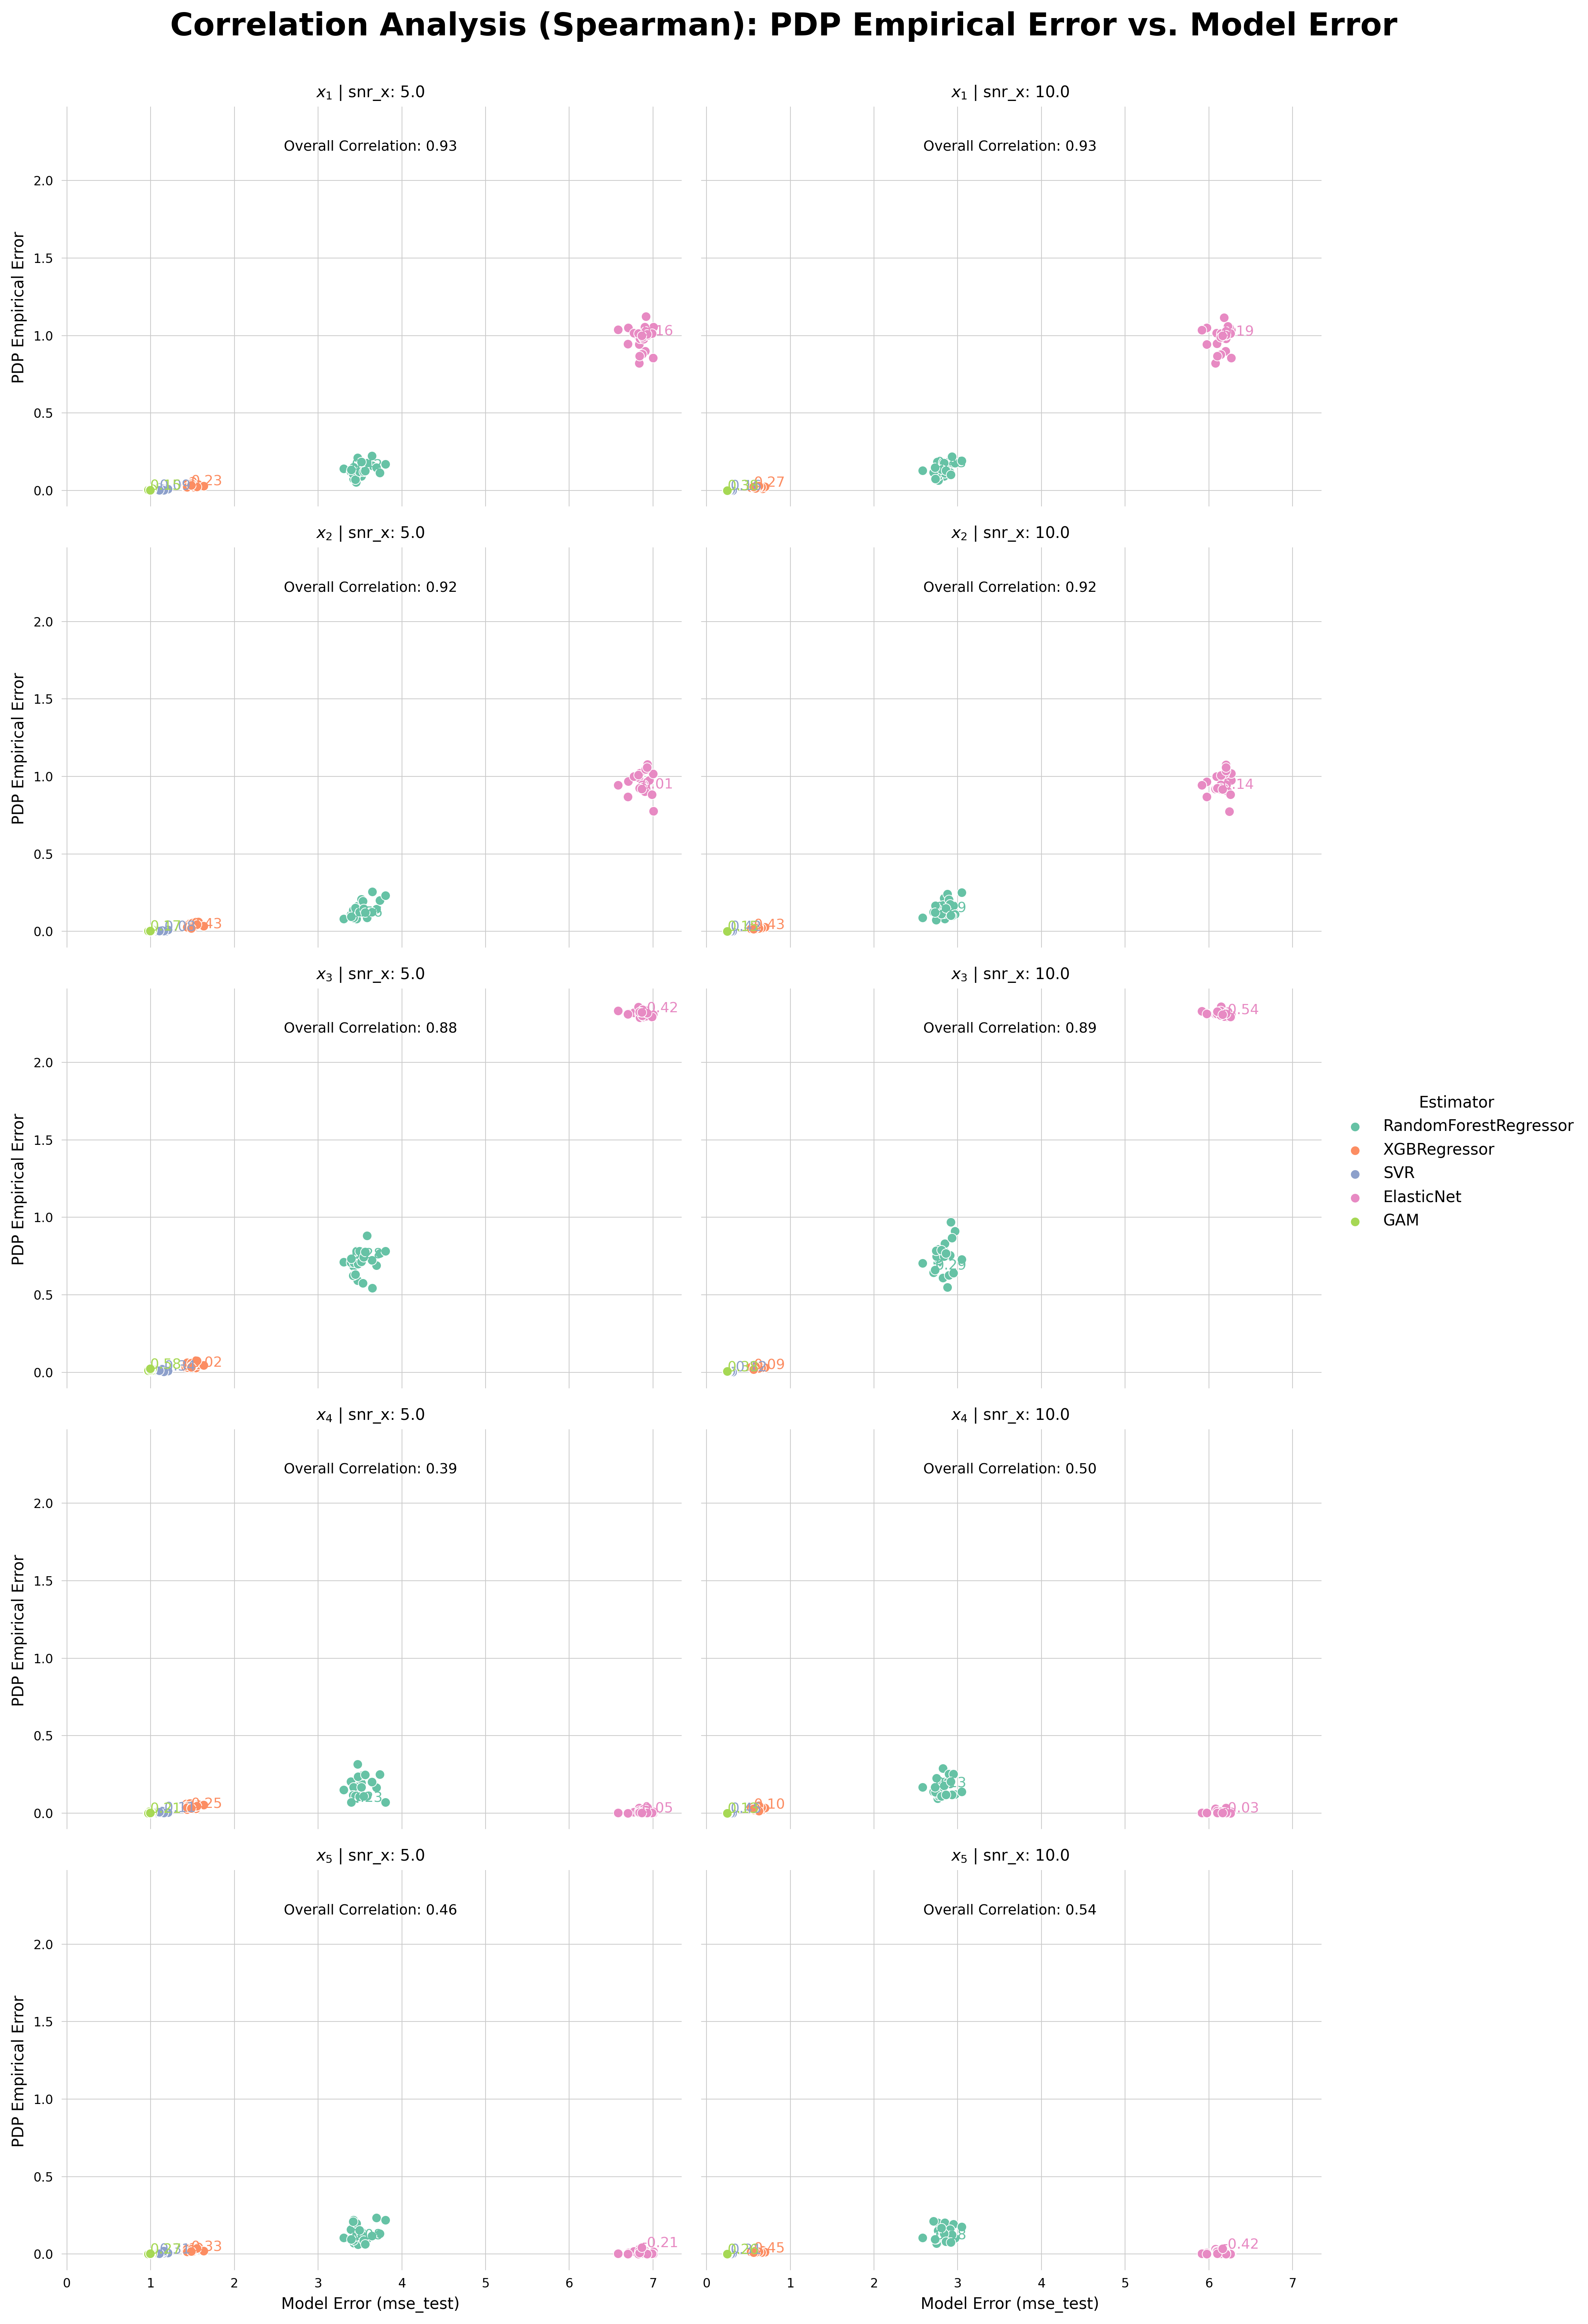
Correlation Analysis Friedman1 [PDP]
feature | snr | model | correlation
x_1 | 5.0 | Overall | 0.930390
 |  | RandomForestRegressor | 0.420769
 |  | XGBRegressor | 0.225385
 |  | SVR | 0.088462
 |  | ElasticNet | 0.155385
 |  | GAM | 0.154615
 | 10.0 | Overall | 0.933155
 |  | RandomForestRegressor | 0.425385
 |  | XGBRegressor | 0.273077
 |  | SVR | 0.159231
 |  | ElasticNet | 0.186923
 |  | GAM | 0.376923
x_2 | 5.0 | Overall | 0.924381
 |  | RandomForestRegressor | 0.557692
 |  | XGBRegressor | 0.427692
 |  | SVR | -0.081538
 |  | ElasticNet | 0.013077
 |  | GAM | 0.173846
 | 10.0 | Overall | 0.922495
 |  | RandomForestRegressor | 0.290769
 |  | XGBRegressor | 0.433846
 |  | SVR | 0.420769
 |  | ElasticNet | 0.135385
 |  | GAM | 0.152308
x_3 | 5.0 | Overall | 0.877217
 |  | RandomForestRegressor | 0.277692
 |  | XGBRegressor | 0.024615
 |  | SVR | -0.340769
 |  | ElasticNet | -0.421538
 |  | GAM | 0.581538
 | 10.0 | Overall | 0.887152
 |  | RandomForestRegressor | 0.286923
 |  | XGBRegressor | 0.090000
 |  | SVR | -0.115385
 |  | ElasticNet | -0.536923
 |  | GAM | 0.383846
x_4 | 5.0 | Overall | 0.394482
 |  | RandomForestRegressor | 0.229231
 |  | XGBRegressor | 0.252308
 |  | SVR | -0.112308
 |  | ElasticNet | 0.045385
 |  | GAM | 0.210769
 | 10.0 | Overall | 0.501512
 |  | RandomForestRegressor | 0.128462
 |  | XGBRegressor | 0.101538
 |  | SVR | 0.448462
 |  | ElasticNet | -0.028462
 |  | GAM | 0.128462
x_5 | 5.0 | Overall | 0.455920
 |  | RandomForestRegressor | 0.080769
 |  | XGBRegressor | 0.330000
 |  | SVR | 0.313077
 |  | ElasticNet | -0.208462
 |  | GAM | 0.269231
 | 10.0 | Overall | 0.543318
 |  | RandomForestRegressor | 0.176923
 |  | XGBRegressor | 0.446923
 |  | SVR | 0.306923
 |  | ElasticNet | -0.418462
 |  | GAM | 0.260769

Slide 33
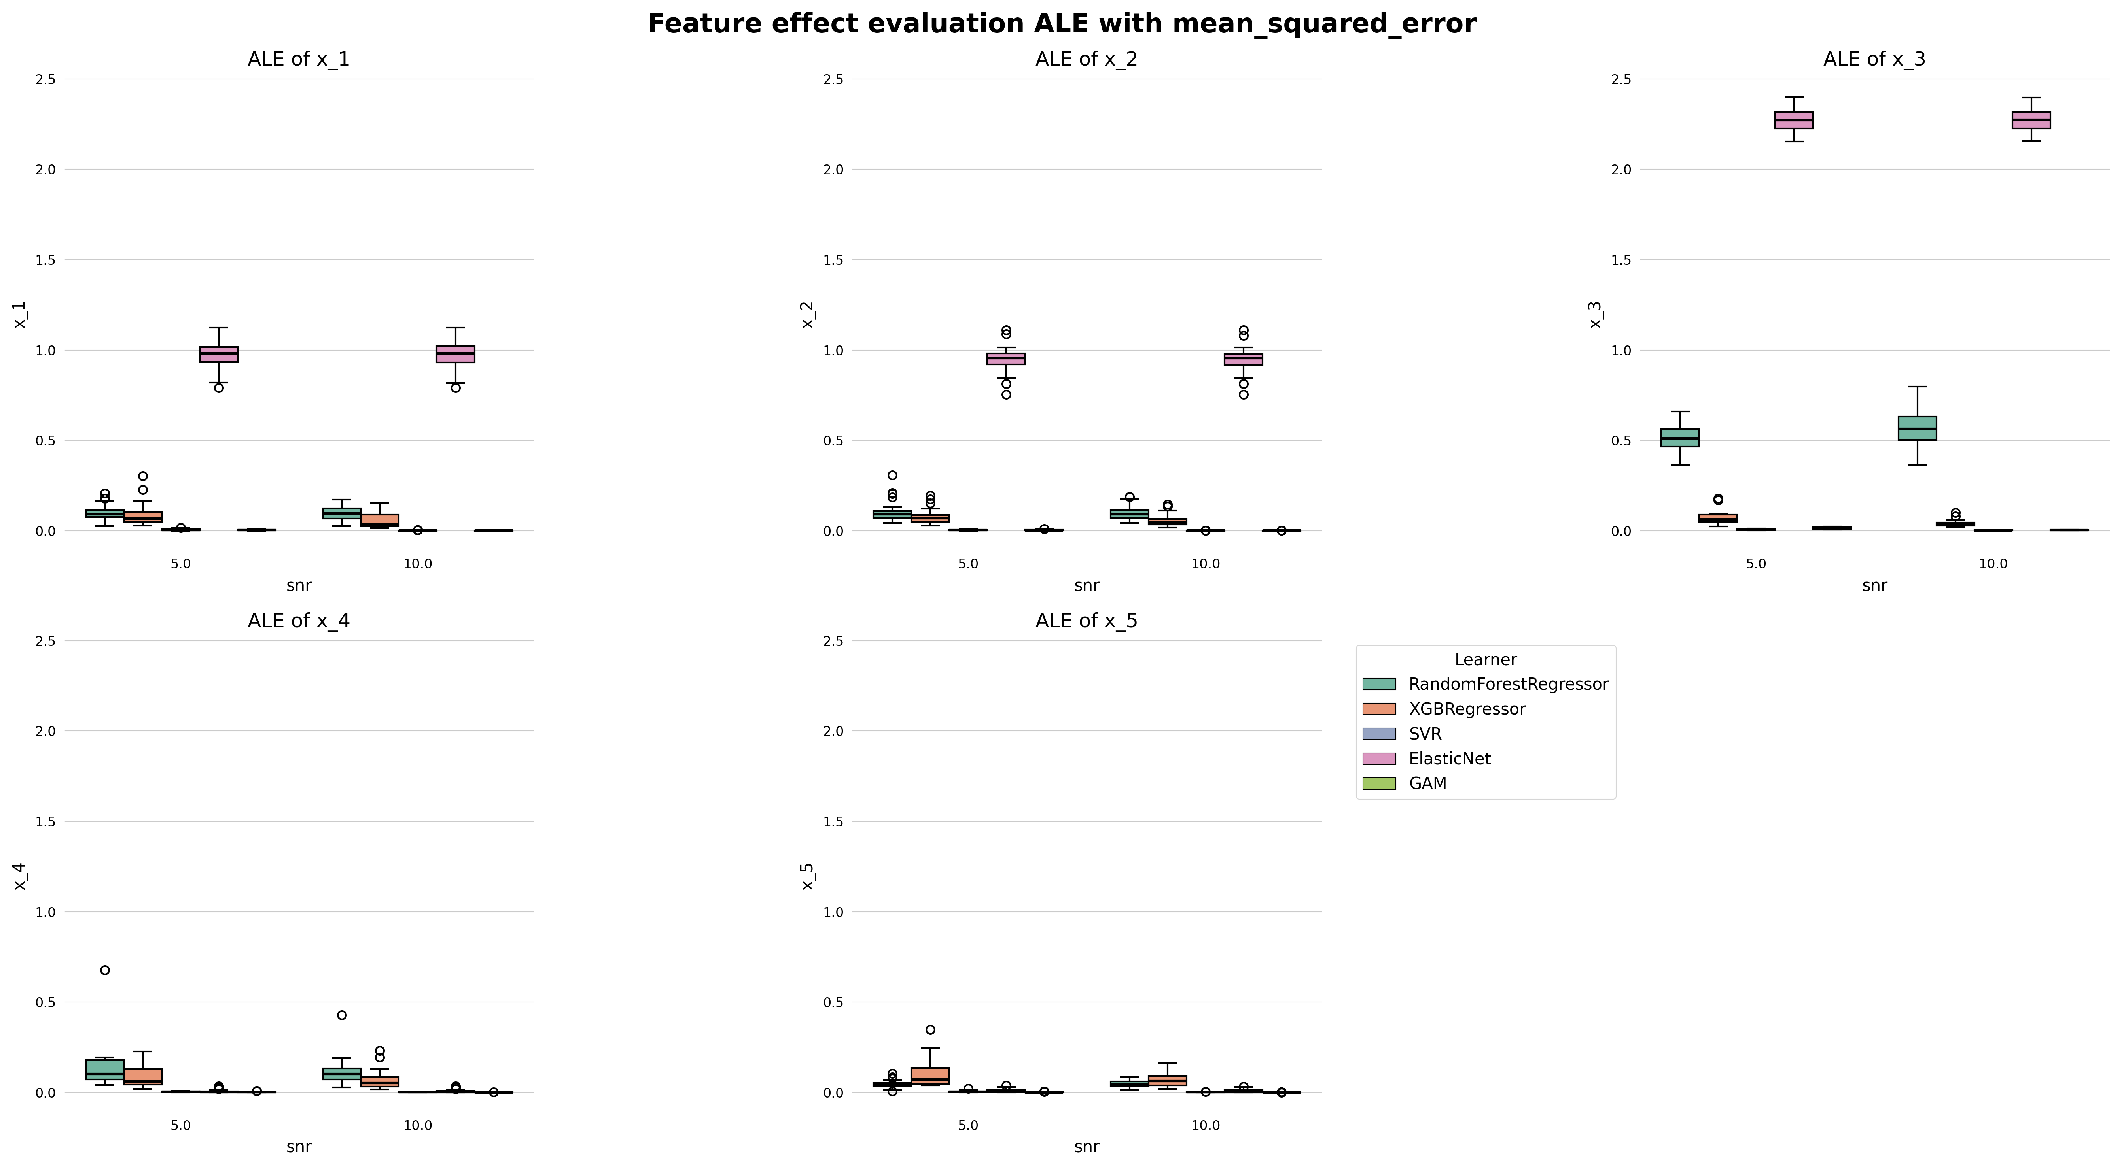
Feature Effect Error Friedman1 [ALE]

Slide 34
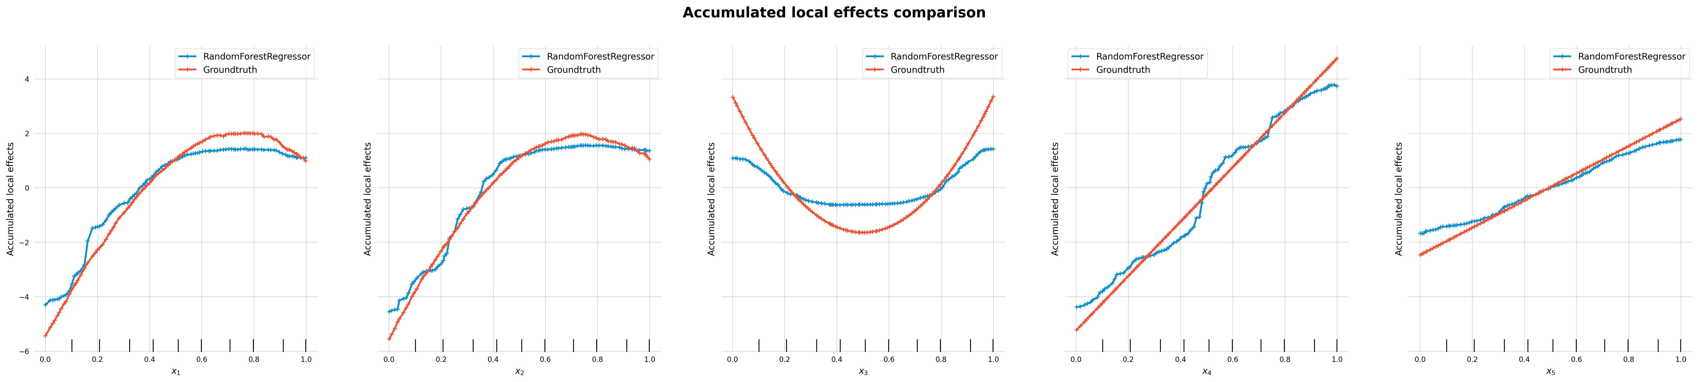
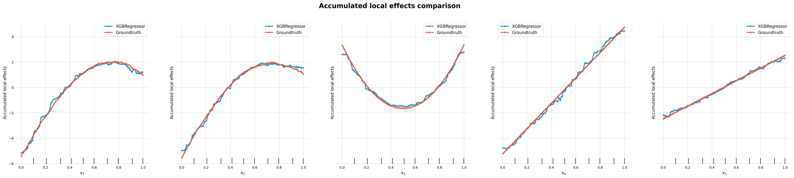
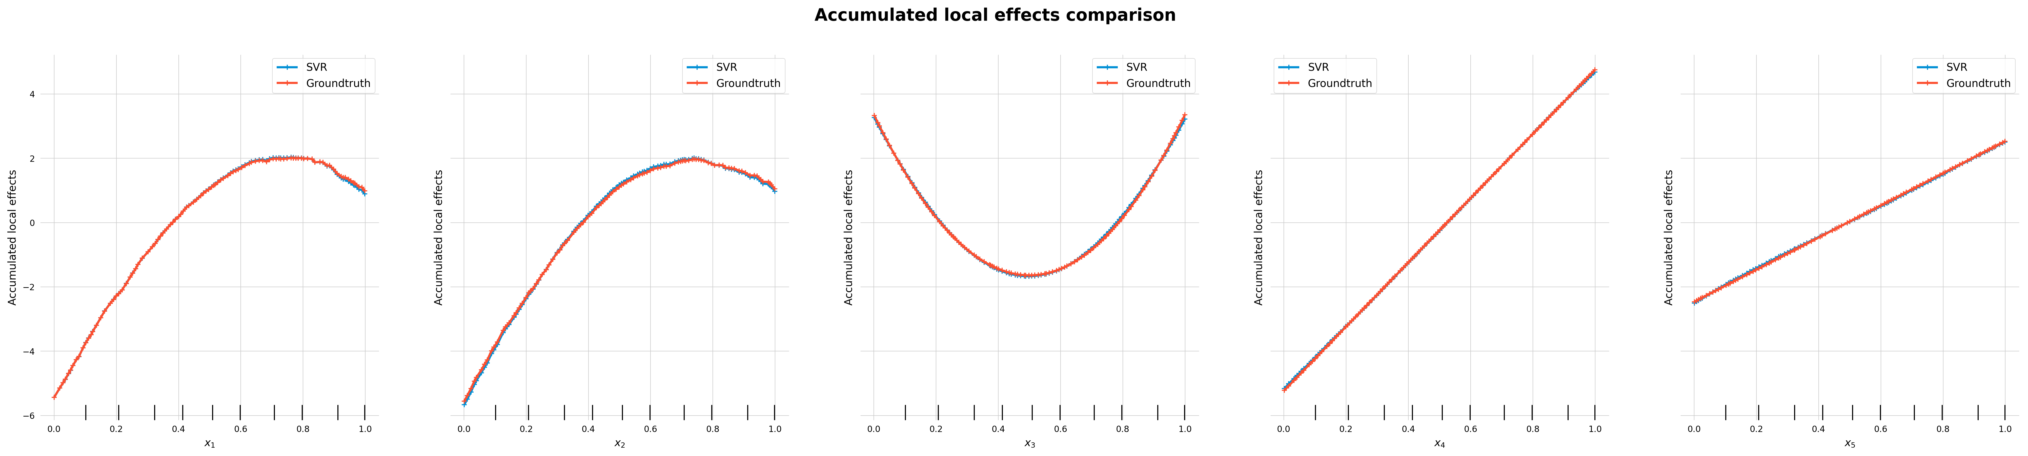

Slide 35
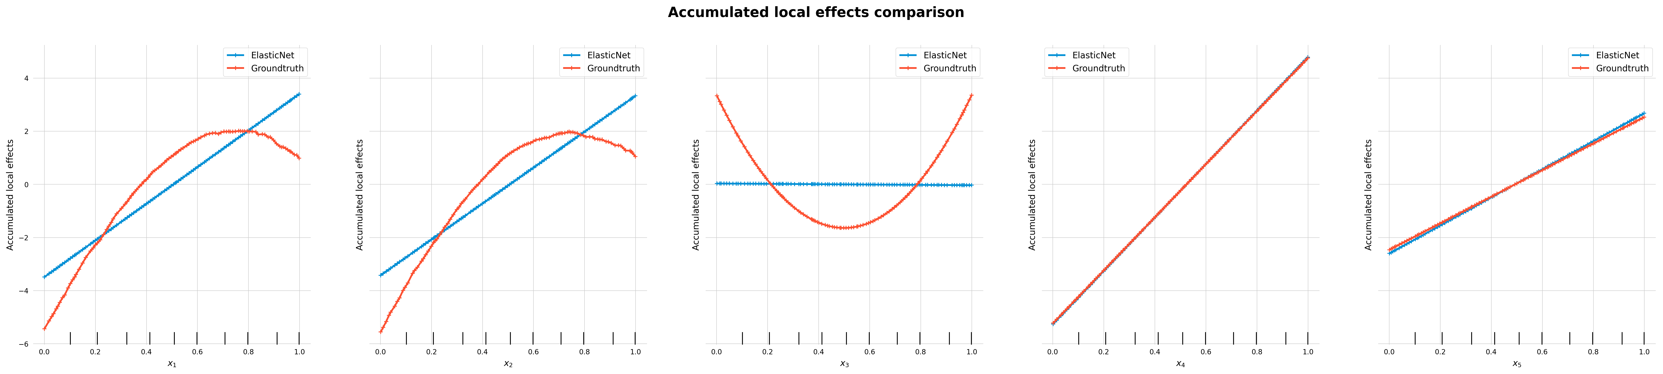
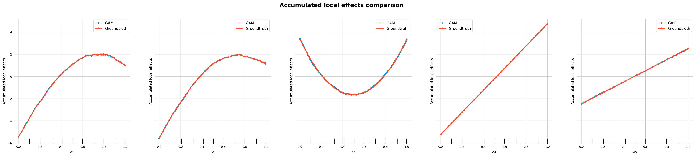

Slide 36
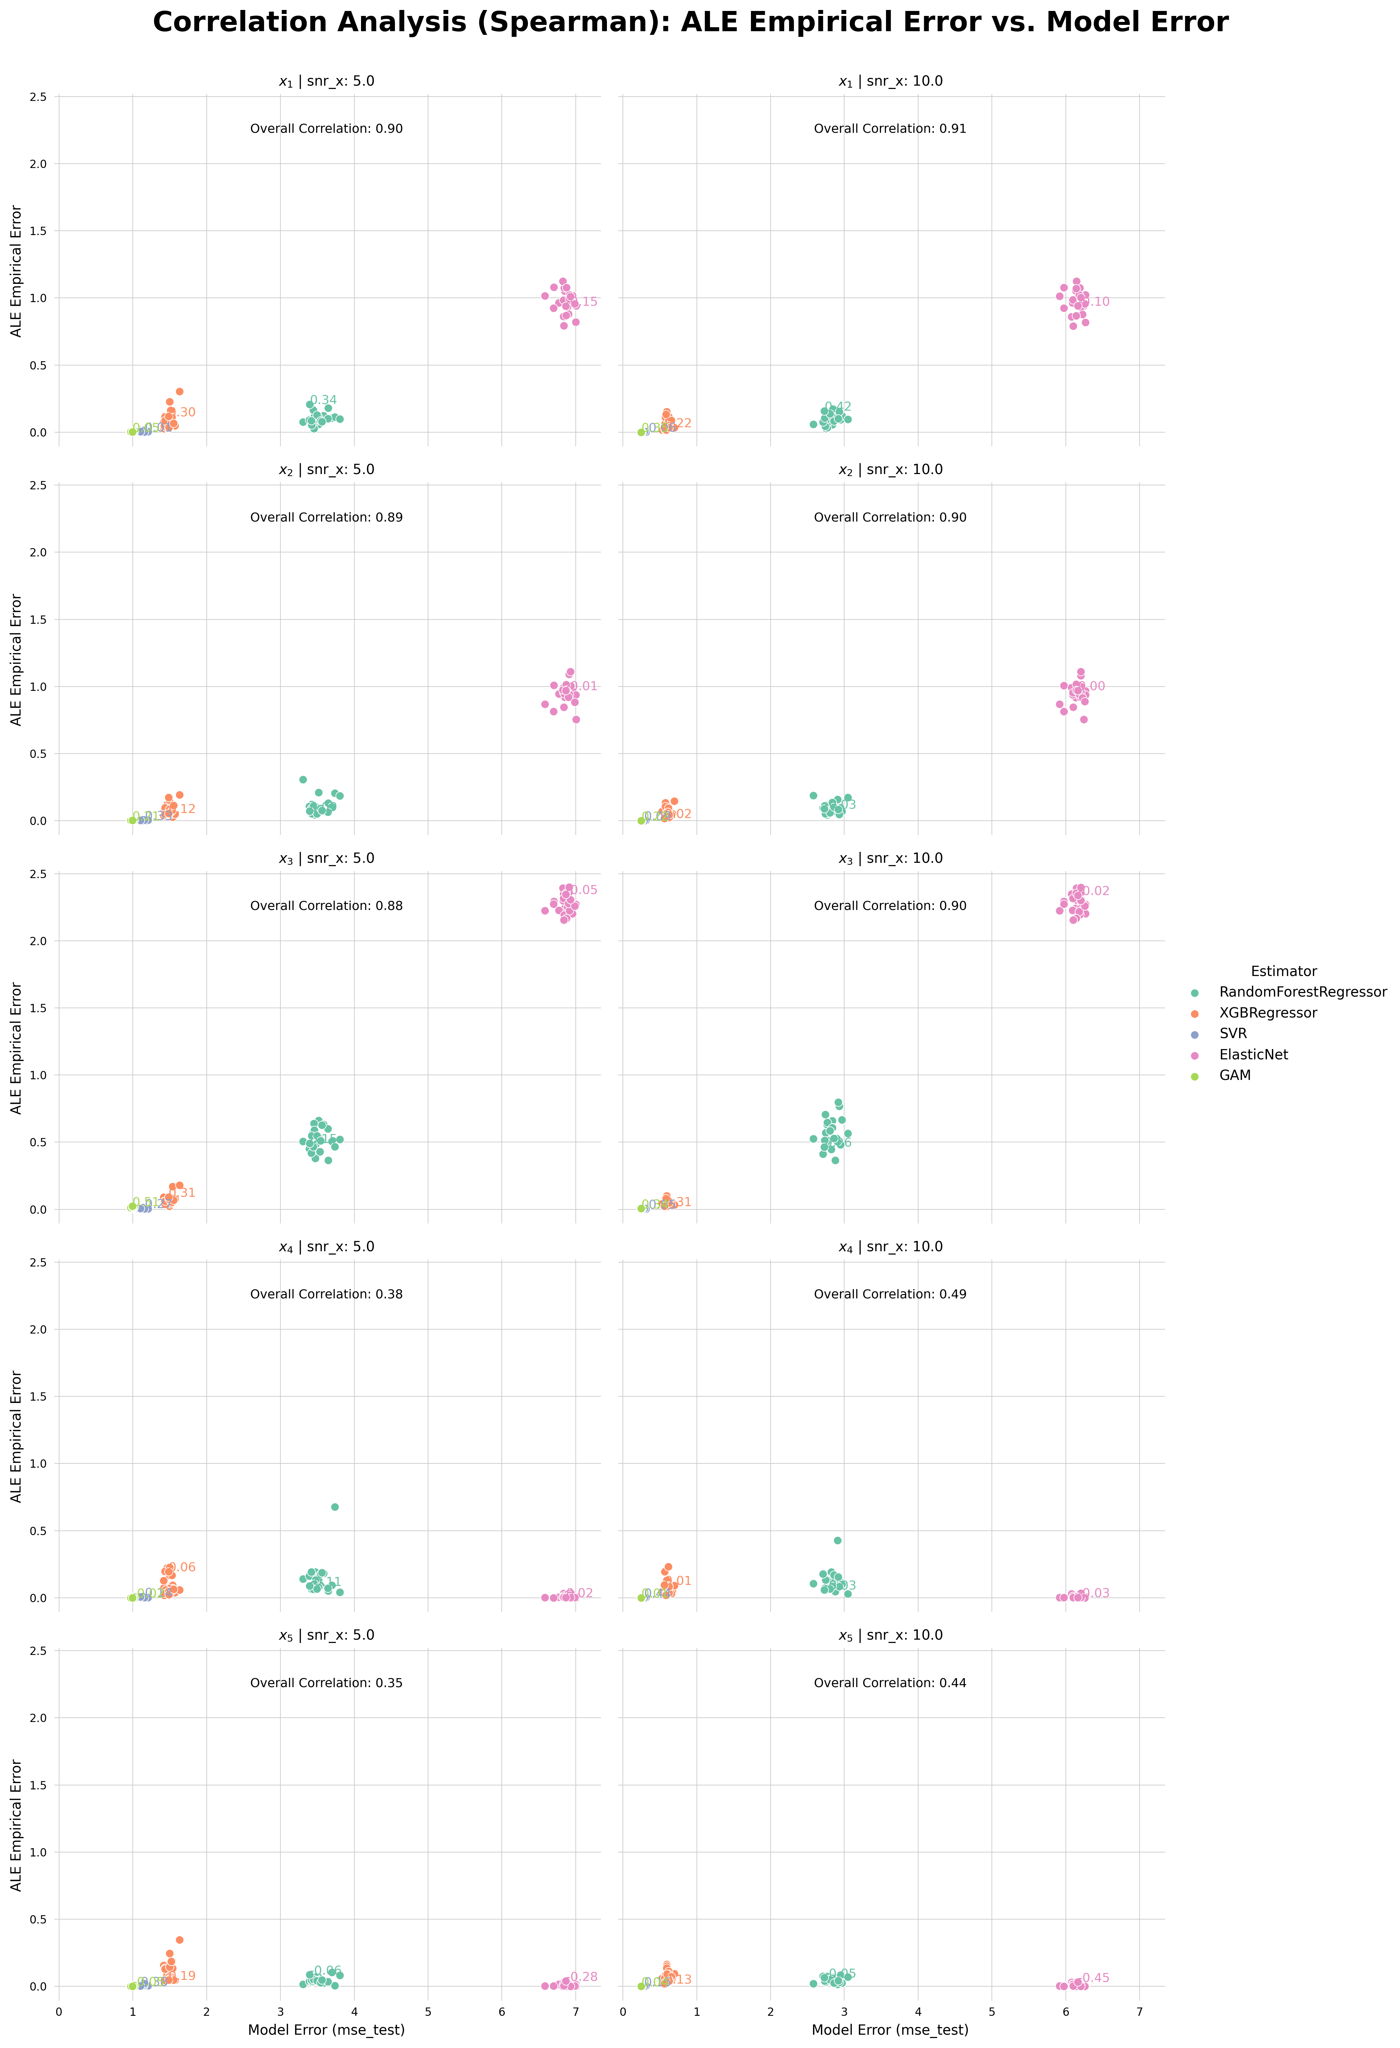
Correlation Analysis Friedman1 [ALE]
feature | snr | model | correlation
x_1 | 5.0 | Overall | 0.895201
 |  | RandomForestRegressor | 0.339231
 |  | XGBRegressor | 0.297692
 |  | SVR | -0.013077
 |  | ElasticNet | -0.153846
 |  | GAM | 0.048462
 | 10.0 | Overall | 0.905493
 |  | RandomForestRegressor | 0.423846
 |  | XGBRegressor | 0.216154
 |  | SVR | -0.056154
 |  | ElasticNet | -0.097692
 |  | GAM | 0.348462
x_2 | 5.0 | Overall | 0.887736
 |  | RandomForestRegressor | 0.090769
 |  | XGBRegressor | 0.116923
 |  | SVR | -0.330000
 |  | ElasticNet | -0.013077
 |  | GAM | 0.207692
 | 10.0 | Overall | 0.897585
 |  | RandomForestRegressor | -0.026923
 |  | XGBRegressor | 0.015385
 |  | SVR | 0.088462
 |  | ElasticNet | 0.002308
 |  | GAM | 0.218462
x_3 | 5.0 | Overall | 0.879515
 |  | RandomForestRegressor | 0.150769
 |  | XGBRegressor | 0.310769
 |  | SVR | -0.274615
 |  | ElasticNet | -0.049231
 |  | GAM | 0.510769
 | 10.0 | Overall | 0.895644
 |  | RandomForestRegressor | 0.258462
 |  | XGBRegressor | 0.308462
 |  | SVR | -0.050000
 |  | ElasticNet | -0.023846
 |  | GAM | 0.342308
x_4 | 5.0 | Overall | 0.380664
 |  | RandomForestRegressor | -0.110000
 |  | XGBRegressor | 0.055385
 |  | SVR | -0.136923
 |  | ElasticNet | 0.021538
 |  | GAM | -0.022308
 | 10.0 | Overall | 0.488762
 |  | RandomForestRegressor | -0.032308
 |  | XGBRegressor | 0.011538
 |  | SVR | 0.443846
 |  | ElasticNet | -0.029231
 |  | GAM | 0.014615
x_5 | 5.0 | Overall | 0.353942
 |  | RandomForestRegressor | -0.058462
 |  | XGBRegressor | 0.186154
 |  | SVR | 0.376923
 |  | ElasticNet | -0.283077
 |  | GAM | -0.048462
 | 10.0 | Overall | 0.441886
 |  | RandomForestRegressor | -0.054615
 |  | XGBRegressor | 0.131538
 |  | SVR | 0.147692
 |  | ElasticNet | -0.448462
 |  | GAM | 0.036923

